Slide 1
Azure - Day 4 Epam DevOps School
Monitor
Automation
Azure AD
SaaS
CONFIDENTIAL | © 2020 EPAM Systems, Inc.

Slide 2
AZ-103T00A Module 06: Monitoring
Notes:
The Network Watcher lab Exercise 1 has a first step to Deploy Azure VMs, an Azure Storage account, and an Azure SQL Database instance by using an Azure Resource Manager template. You may want to do that step before starting the lecture.

Slide 3
Module Overview
Azure Monitor
Azure Alerts
Log Analytics
Network Watcher
Lab and Review Questions
Notes:
Module overview

Slide 4
Lesson 01: Azure Monitor

Slide 5
Azure Monitor Overview
Azure Monitor Service
Key Capabilities
Monitoring Data Platform
Log Data
Data Types
Azure Advisor
Activity Log
Query the Activity Log
Event Categories
Notes:
Lesson overview

Slide 6
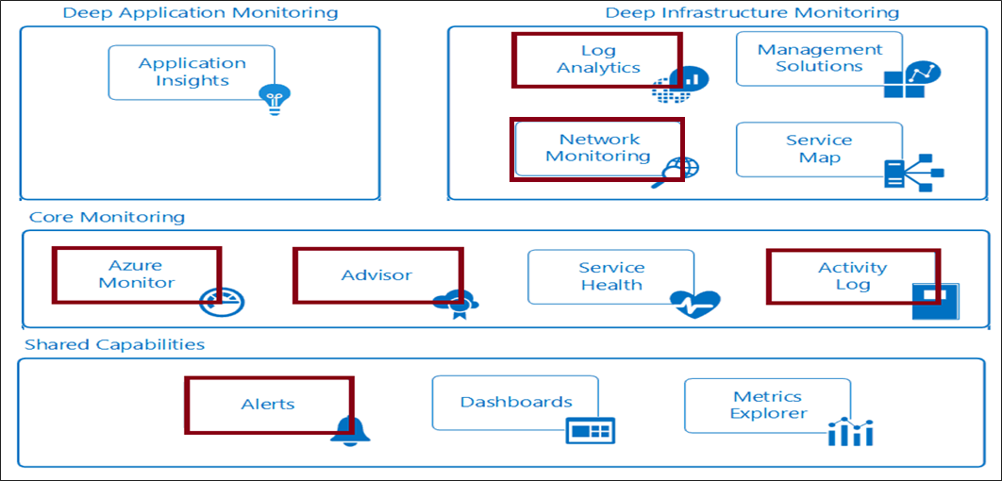
Introducing Azure Monitor Service
Notes:
✔ In this course we will cover the services that will help you with materials in the other courses. Specifically, the highlighted items in the diagram are covered in this course.
For more information, you can see:
Azure Monitor Documentation- https://docs.microsoft.com/en-us/azure/azure-monitor/
Video - Azure Monitor Overview - https://youtu.be/_hGff5bVtkM

Slide 7



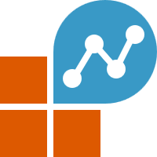
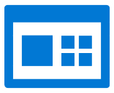
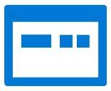










Azure Monitor overview
Azure Monitor
Insights
Application
Container
VM
Monitoring
solutions
Application
Operating system
Visualize
Azure resources
Dashboards
Views
Power BI
Workbooks
Azure subscription
Metrics
Analyze
Azure tenant
Metric Analytics
Log Analytics
Logs
Respond
Custom sources
Alerts
Autoscale
Integrate
Event Hubs
Logic Apps
Ingest and
export APIs
Notes:
The following diagram gives a high-level view of Azure Monitor. At the center of the diagram are the data stores for metrics and logs, which are the two fundamental types of data use by Azure Monitor. On the left are the sources of monitoring data that populate these data stores. On the right are the different functions that Azure Monitor performs with this collected data such as analysis, alerting, and streaming to external systems.

Slide 8
What data does Azure Monitor collect?
Azure Monitor can collect data from:
Application monitoring data
Guest OS monitoring data
Azure resource monitoring data
Azure subscription monitoring data
Azure tenant monitoring data
Notes:
Azure Monitor can collect data from a variety of sources. You can think of monitoring data for your applications in tiers ranging from your application, any operating system and services it relies on, down to the platform itself. Azure Monitor collects data from each of the following tiers:
Application monitoring data: Data about the performance and functionality of the code you have written, regardless of its platform.
Guest OS monitoring data: Data about the operating system on which your application is running. This could be running in Azure, another cloud, or on-premises.
Azure resource monitoring data: Data about the operation of an Azure resource.
Azure subscription monitoring data: Data about the operation and management of an Azure subscription, as well as data about the health and operation of Azure itself.
Azure tenant monitoring data: Data about the operation of tenant-level Azure services, such as Azure Active Directory.

Slide 9
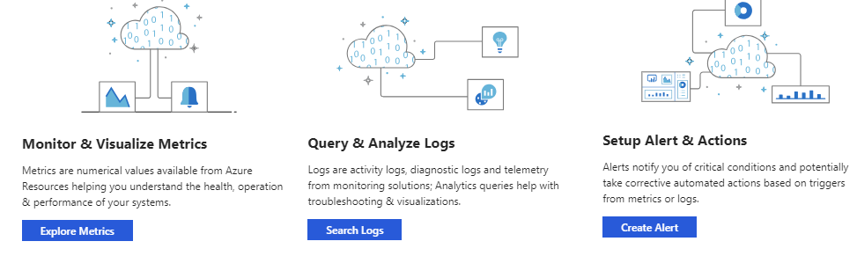
Azure Monitor: Key Capabilities
Core monitoring for Azure services
Collects metrics, activity logs, and diagnostic logs
Use for time critical alerts and notifications

Slide 10
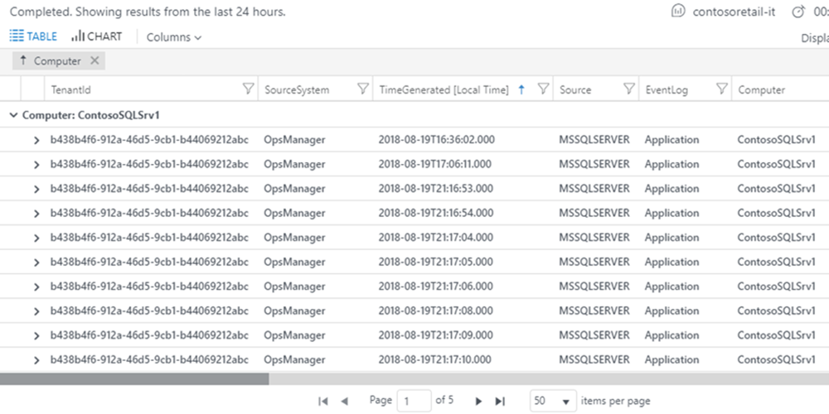
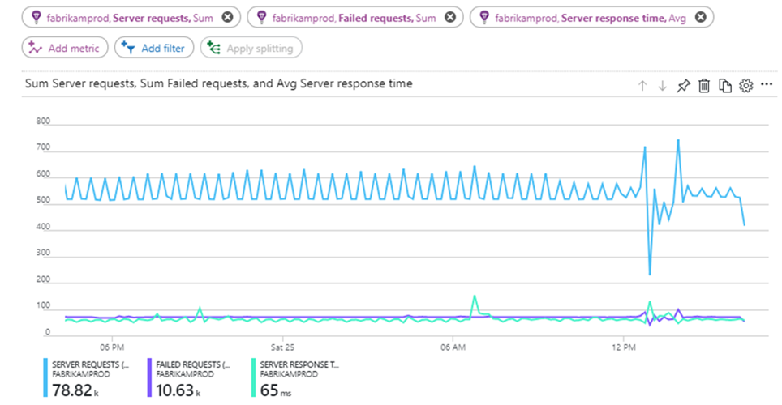

Monitoring data platform
Logs
Metrics
Log Analytics
Metrics Explorer
Notes:
All data collected by Azure Monitor fits into one of two fundamental types, metrics and logs. Metrics are numerical values that describe some aspect of a system at a particular point in time. They are lightweight and capable of supporting near real-time scenarios. Logs contain different kinds of data organized into records with different sets of properties for each type. Telemetry such as events and traces are stored as logs in addition to performance data so that it can all be combined for analysis.
Log data collected by Azure Monitor is stored in Log Analytics, which includes a rich query language to quickly retrieve, consolidate, and analyze collected data. You can create and test queries by using the Log Analytics page in the Azure portal and then either directly analyze the data by using these tools or save queries for use with visualizations or alert rules.

Slide 11
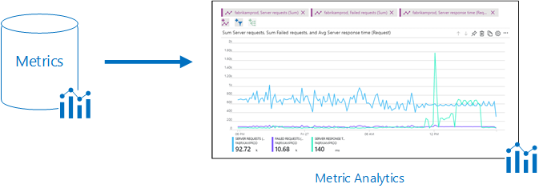
Monitoring Data Platform
Metrics are numerical values that describe some aspect of a system at a point in time. They are lightweight and capable of supporting near real-time scenarios.
Logs contain different kinds of data organized into records with different sets of properties for each type. Telemetry such as events and traces are stored as logs in addition to performance data so that it can all be combined for analysis.

Slide 12
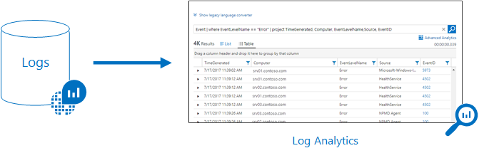
Log Data
Log data is stored in Log Analytics which includes a rich query language to quickly retrieve, consolidate, and analyze collected data
The Data Explorer query language that is suitable for simple log queries but also includes advanced functionality such as aggregations, joins, and smart analytics

Slide 13
Data Types
Application monitoring data - Performance and functionality of the code you have written, regardless of its platform
Guest OS monitoring - Azure, another cloud, or on-premises
Azure resource monitoring
Azure subscription monitoring - Operation and management of an Azure subscription, as well as data about the health and operation of Azure itself
Azure tenant monitoring – Operation of tenant-level Azure services, such as Azure Active Directory
Notes:
For more information, you can see:
Azure Fridays, Azure Monitor - [https://channel9.msdn.com/Shows/Azure-Friday/Azure-Monitor/player](https://channel9.msdn.com/Shows/Azure-Friday/Azure-Monitor/player)

Slide 14









Azure Monitor sources
Autoscale
Notifications Engine
Application Insights
Resource
Log Analytics
Metrics
Event Hubs
Azure Infrastructure
Azure Storage
Azure Portal
Azure PowerShell
Azure CLI
REST API
3rd Party Tools
Notes:
All data collected by Azure Monitor fits into one of two fundamental types, metrics and logs.
Metrics are numerical values that describe some aspect of a system at a particular point in time. They are lightweight and capable of supporting near real-time scenarios.
Logs contain different kinds of data organized into records with different sets of properties for each type. Telemetry such as events and traces are stored as logs in addition to performance data so that it can all be combined for analysis.

Slide 15
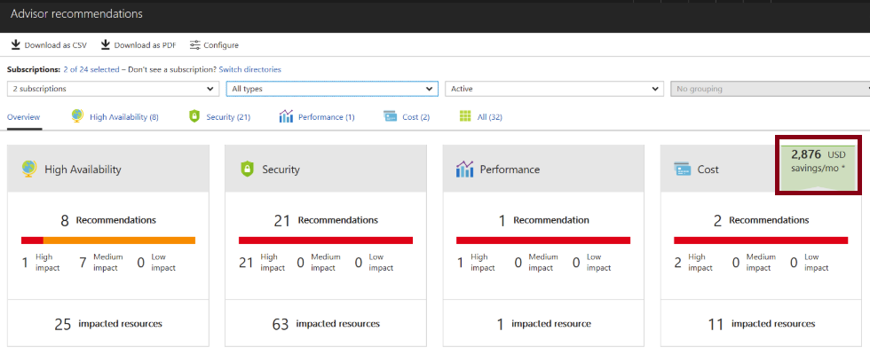
Azure Advisor
Personalized cloud consultant
Analyzes your configuration and recommends solutions
Four areas: High Availability, Security, Performance, and Cost
Notes:
✔ Advisor provides recommendations for virtual machines, availability sets, application gateways, App Services, SQL servers, and Redis Cache.

Slide 16
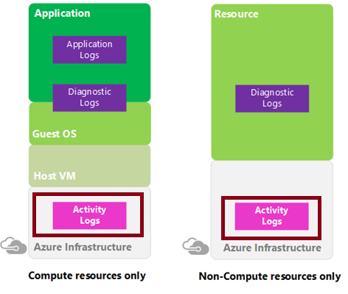
Activity Log
Send data to Log Analytics for advanced search and alerts
Query or manage events in the Portal, PowerShell, CLI, and REST API
Stream information to Event Hub
Archive data to a storage account
Analyze data with Power BI
Notes:
✔ Activity Logs provide data about the operations on a resource from the outside (the "control plane"). Diagnostics Logs are emitted by a resource and provide information about the operation of that resource (the "data plane"). Activity logs are kept for 90 days. You can query for any range of dates, as long as the starting date isn't more than 90 days in the past.

Slide 17
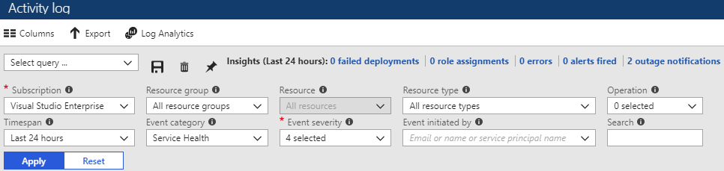
Query the Activity Log
Filter by: Subscription, Resource group, Resource (name), Resource type, Operation name, Timespan, Category, Severity, and Event initiated by
Notes:
✔ Once you have defined a set of filters, you can save it as a query that is persisted across sessions if you ever need to perform the same query with those filters applied again in the future. You can also pin a query to your Azure dashboard to always keep an eye on specific events.
For more information, you can see:
Query the Activity Log in the Azure portal - https://docs.microsoft.com/en-us/azure/monitoring-and-diagnostics/monitoring-overview-activity-logs#query-the-activity-log-in-the-azure-portal

Slide 18
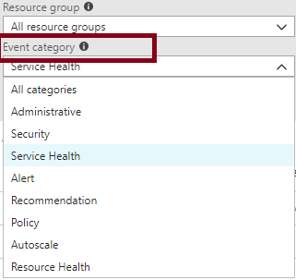
Event Categories
Administrative events
Service health events with status
Alert events
Autoscale events
Usage recommendations
Security events
Policy and Resource Health (reserved)

Slide 19
Application Insights
Application Map:
Diagram of App Components and interactions between all services
Live Metrics:
Real-Time Requests information
Servers:
Detailed Performance per Instance view
Availability:
Run scheduled tests for Uptime
Notes:
20535A
12: Monitoring & Automating Azure Solutions

Slide 20
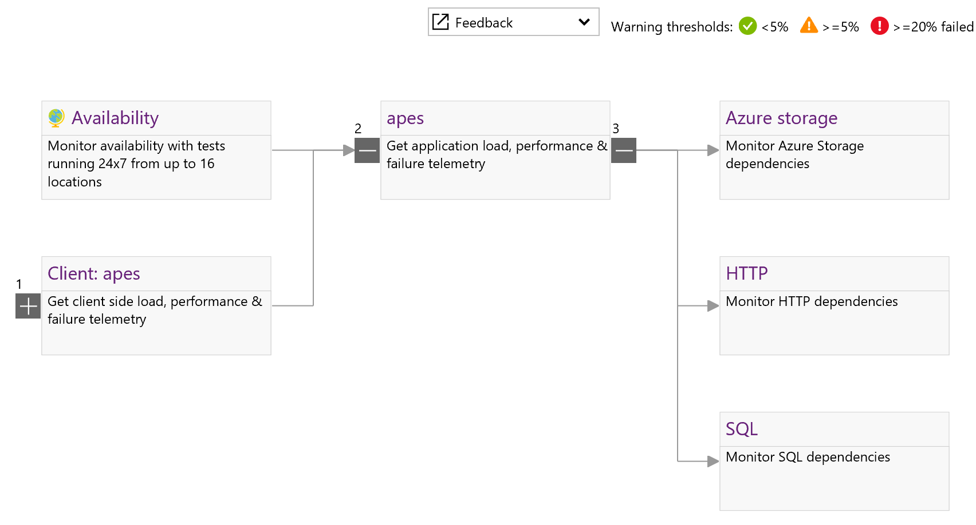
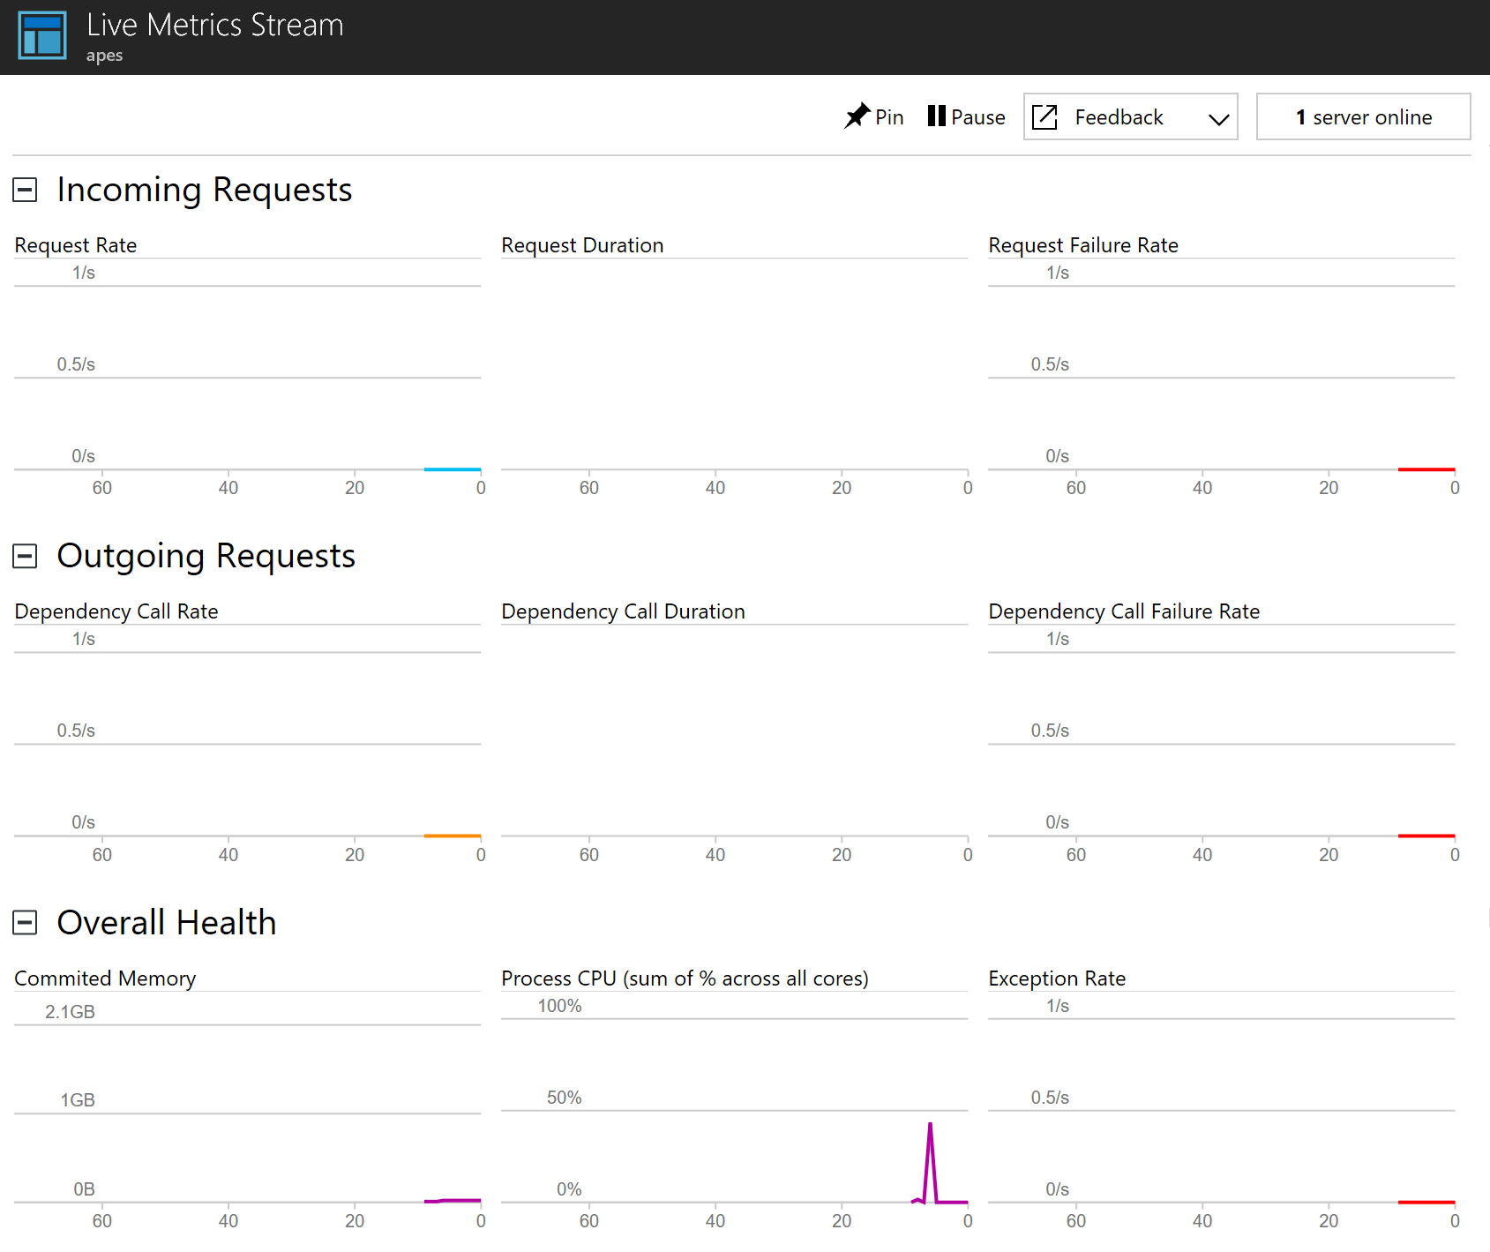
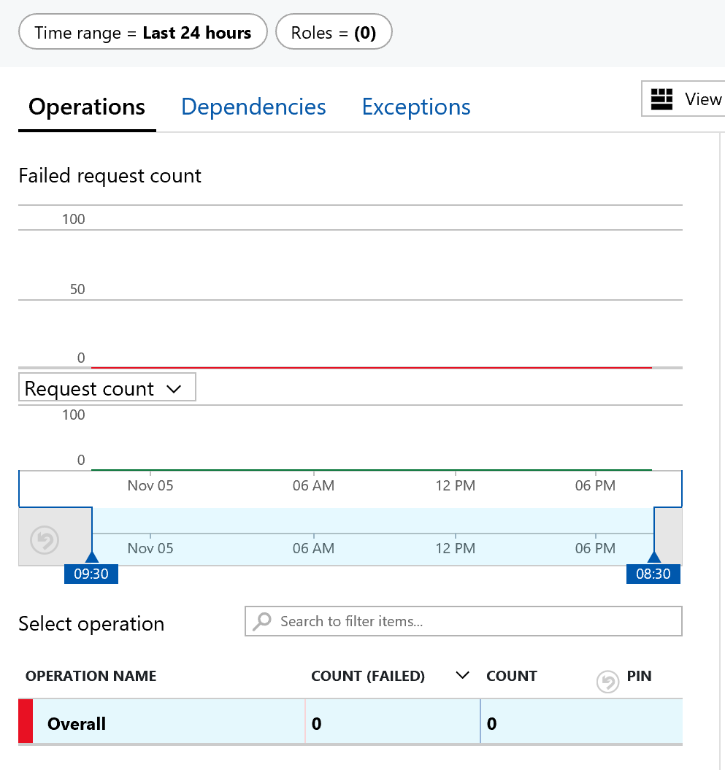
Application Insights
Notes:
Examples of reports created by Application Insights in the portal.
20535A
12: Monitoring & Automating Azure Solutions

Slide 21
Lesson 02: Azure Alerts

Slide 22
Azure Alerts Overview
Azure Monitor Alerts
Creating Alert Rules
Action Groups
Managing Alerts
Alerts Experience
Alert Detail Page
Create an Alert
Demonstration - Alerts
Notes:
Lesson overview

Slide 23
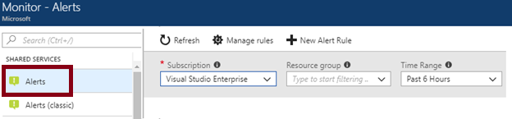
Azure Monitor Alerts
Better notification system
Unified authoring experience
Log Analytics alerts display in Azure portal
Separation of Fired Alerts and Alert Rules
Improved workflow
Notes:
For more information, you can see:
The new alerts experience in Azure Monitor - https://docs.microsoft.com/en-us/azure/monitoring-and-diagnostics/monitoring-overview-unified-alerts

Slide 24
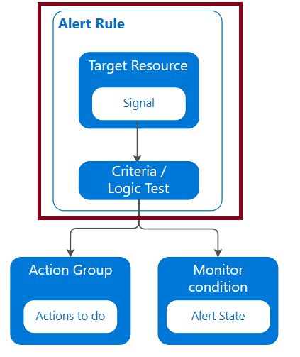
Creating Alert Rules
Define alert conditions: Target selection, Alert criteria, and Alert logic
Define alert details: Alert rule name, description, and severity (0 to 4)
Define action group: notify your team via email and text messages or automate actions using webhooks and runbooks.

Slide 25
Action Groups
Notifies a group of users that an alert has been triggered
Is a collection of notification preferences
Email/SMS/Voice
Azure Function
Logic App
Webhook
IT Service Management
Automation Runbook

Slide 26
Managing Alerts
State | Description
New | The issue has just been detected and has not yet been reviewed.
Acknowledged | An administrator has reviewed the alert and started working on it.
Closed | The issue has been resolved. After an alert has been closed, you can reopen it by changing it to another state.
You can alert on metrics and logs as such as: Metric values, log search queries, activity log events, health of the underlying Azure platform, and tests for web site availability
Notes:
✔️ Alert state is different and independent of the monitor condition. Alert state is set by the user. Monitor condition is set by the system. When an alert fires, the alert's monitor condition is set to fired. When the underlying condition that caused the alert to fire clears, the monitor condition is set to resolved. The alert state isn't changed until the user changes it.

Slide 27
Alerts Experience
Subscription – View up to five Azure subscriptions
Resource Group – One resource group at a time
Time range - Past hour, the past 24 hours, the past 7 days, and the past 30 days.

Slide 28
Alert Detail Page
Essentials
History
Smart group
More details

Slide 29
Create an Alert
Resource
Condition
Action Group
Alert rule name
Description
Enable rule upon creation
Notes:
Alert rule name, description, and enable rule upon completion are not shown in the graphic.

Slide 30
Demonstration - Alerts
Create an alert rule
Explore alert targets
Explore alert conditions
Explore alert details
Notes:
✔ Always consider having students walk-through the demonstrations themselves. Also, consider the overlap with the formal labs and your best use of time.

Slide 31
Lesson 03: Log Analytics

Slide 32
Log Analytics Overview
Log Analytics Scenarios
Create a Workspace
Connected Sources
Data Sources
Log Analytics Querying
Query Language Syntax
Demonstration – Log Analytics
Notes:
Lesson overview

Slide 33
Log Analytics Scenarios
Example 1 - Assessing updates
IT Administrators assess systems update requirements
Must be able to accurately schedule updates
OMS/Log Analytics collects data from all customers performing updates
Uses "Crowd-sourced" data to provide an average time to help meet strict SLAs
Example 2 - Change tracking
Troubleshooting operational incidents is a complex process
OMS/Log Analytics let you perform analysis from multiple angles, using a variety of sources
Everything correlated through a single interface
Track issues such as unexpected system reboots or shutdowns
Notes:
For more information, you can see:
‎What is Log Analytics? https://docs.microsoft.com/en-us/azure/log-analytics/log-analytics-overview
What’s new in Microsoft Operations Management Suite: Log Analytics - https://blog.tyang.org/wp-content/uploads/2016/04/Whats-New-in-OMS.pdf
Log Analytics FAQ - https://azure.microsoft.com/en-us/services/log-analytics/faq/
Unified Alerts in Log Analytics - https://docs.microsoft.com/en-us/azure/log-analytics/log-analytics-alerts

Slide 34
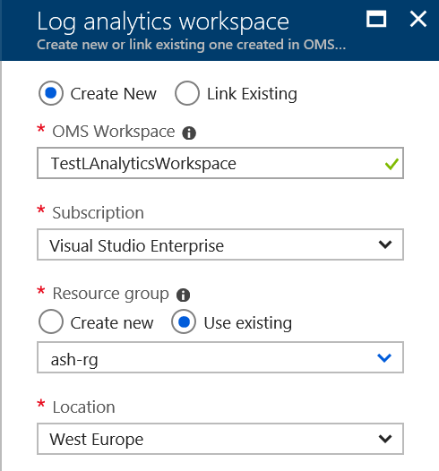
Create a Workspace
A workspace is an Azure resource and is a container where data is collected, aggregated, analyzed, and presented
You can have multiple workspaces per Azure subscription, and you can have access to more than one workspace
A workspace provides a geographic location, data isolation, and scope

Slide 35
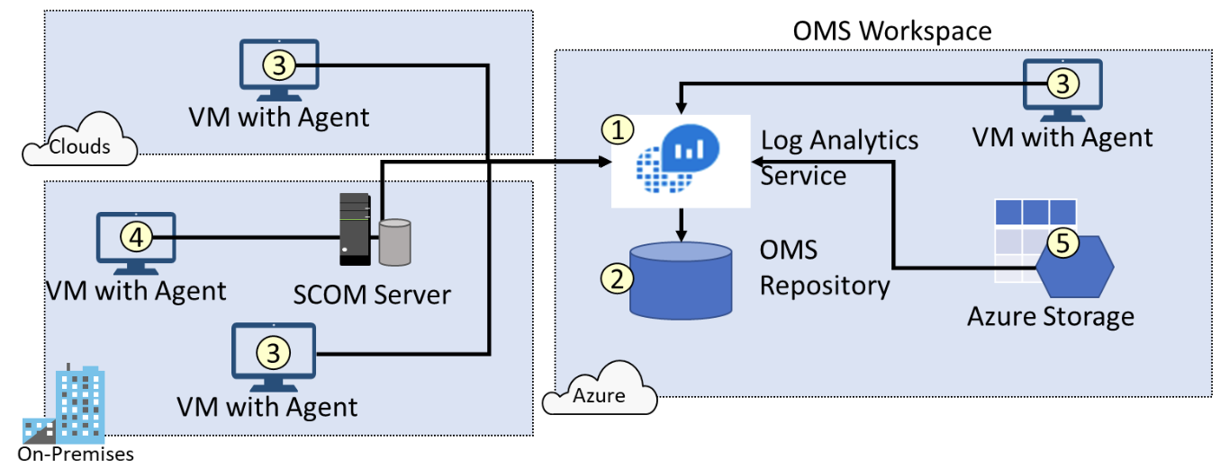
Connected Sources
Connected Sources generate data
Data can be collected from Windows, Linux, SCOM and Azure Storage

Slide 36
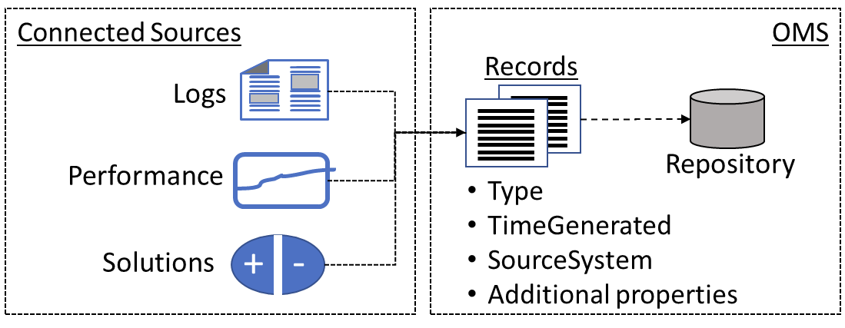
Data Sources
Data sources include: Windows Event Logs, Windows Performance Counters, Linux Performance Counters, IIS Logs, Custom Fields, Custom Logs, and Syslog.
Each data source has additional configuration options.

Slide 37
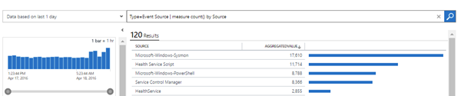
Log Analytics Querying
Log Analytics provides a query syntax
Quickly retrieve and consolidate data in the repository
Save or have log searches run automatically to create an alert
Export the data to Power BI or Excel

Slide 38
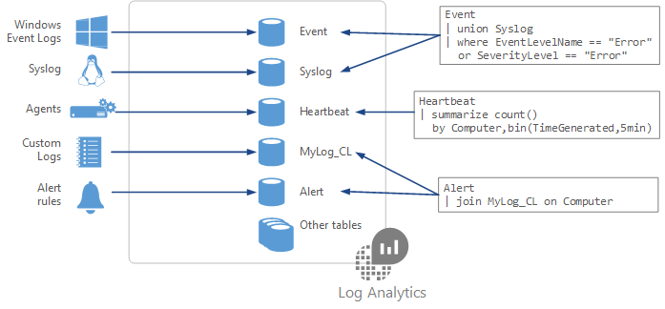
Query Language Syntax
Event
| where (EventLevelName == "Error")
| where (TimeGenerated > ago(1days))
| summarize ErrorCount = count() by Computer
| top 10 by ErrorCount desc
Notes:
For more information, you can see:
Azure Monitor log queries - https://docs.microsoft.com/en-us/azure/azure-monitor/log-query/query-language

Slide 39
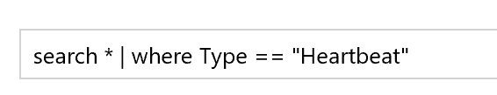
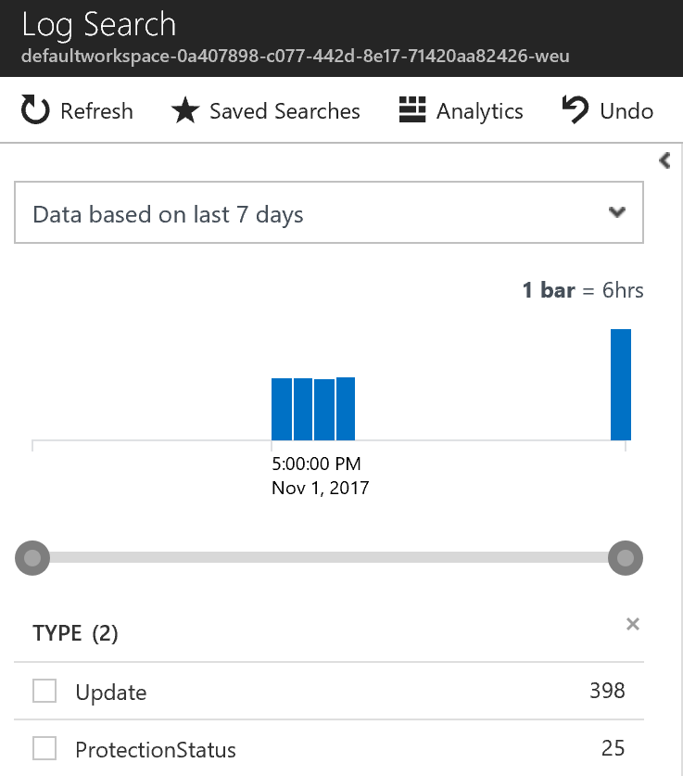
Operations Management Suite – Log Analytics
Powerful Query Language
Click-to-filter scenarios
Saved Search
Export to CSV
Use “Azure Log Analytics” for more advanced querying (portal.loganalytics.io)
Notes:
20535A
12: Monitoring & Automating Azure Solutions

Slide 40
Demonstration – Log Analytics
Access the demonstration environment
Use the Query Explorer
Notes:
✔ Always consider having students walk-through the demonstrations themselves. Also, consider the overlap with the formal labs and your best use of time.

Slide 41
Power BI
“Workspace approach, integrating with Power BI Apps, allowing for detailed reporting and data analytics”
Connect to different data sources, create reports and data charts
Get access to powerful dashboards, alerts and drill down for info
Simplify Mgmt, expose IT data to non-IT teams, achieve compliance
Embed interactive data visuals and reporting features into your apps
Monitoring, Management + Business Continuity & Disaster Recovery
Notes:
20535A
12: Monitoring & Automating Azure Solutions

Slide 42
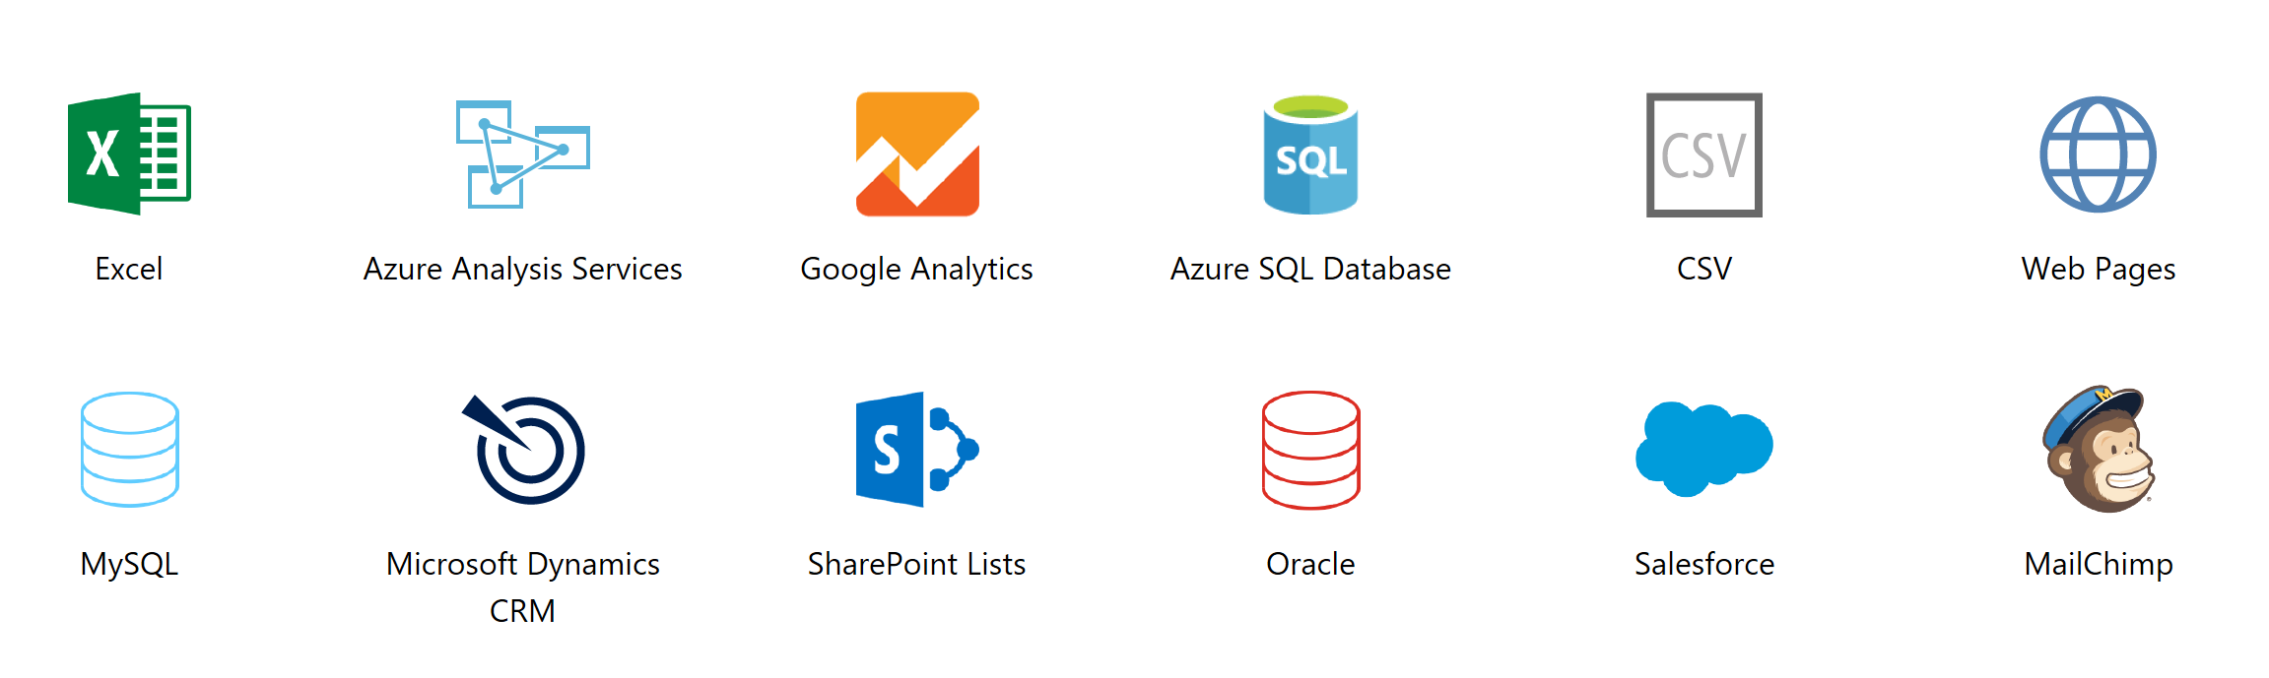
Power BI
Integrating with Industry-Standard Data Sources
Notes:
20535A
12: Monitoring & Automating Azure Solutions

Slide 43
Lesson 04: Network Watcher

Slide 44
Network Watcher Overview
Network Watcher
Monitoring and Visualization
Diagnostics – IP Flow Verify
Diagnostics – Next Hop
Diagnostics – VPN Diagnostics
NSG Flow Logs
Connection Troubleshoot
Notes:
Lesson overview

Slide 45
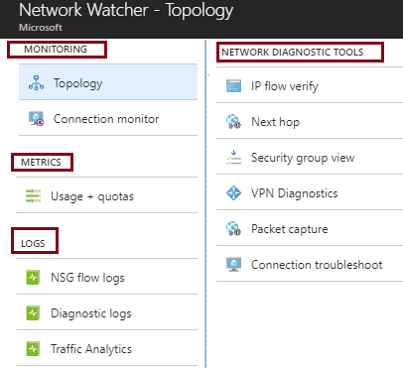
Network Watcher
Is a regional service
Provides tools to monitor, diagnose, view metrics, and enable or disable logs
Provides scenario level monitoring so you can diagnose problems at an end to end network level view
Notes:
✔ The Network Watcher instance is automatically created in a resource group named NetworkWatcherRG.
For more information, you can see:
Network Watcher - https://azure.microsoft.com/en-us/services/network-watcher/

Slide 46
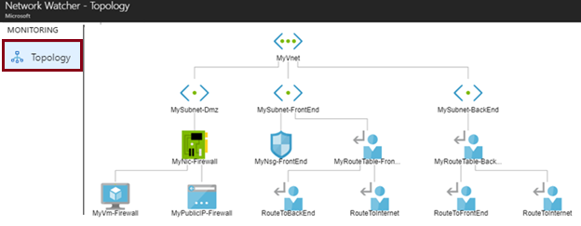
Monitoring and Visualization
Provides a visual representation of your networking elements
View all the resources in a virtual network, resource to resource associations, and relationships between the resources
Notes:
✔ To use Network Watcher capabilities, the account you log into Azure with, must be assigned to the Owner, Contributor, or Network contributor built-in roles, or assigned to a custom role. A custom role can be given permissions to read, write, and delete the Network Watcher.

Slide 47
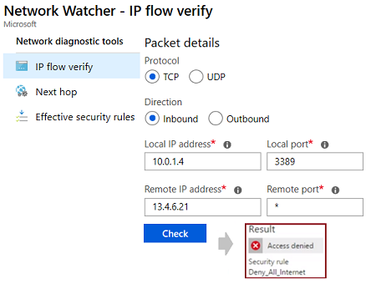
Diagnostics - IP Flow Verify
Diagnose connectivity issues from or to the internet and from or to the on-premises environment. Ideal for ensuring security rules are being correctly applied.
Notes:
✔ IP flow verify is ideal for making sure security rules are being correctly applied. When used for troubleshooting, if IP flow verify doesn’t show a problem, you will need to explore other areas such as firewall restrictions.

Slide 48
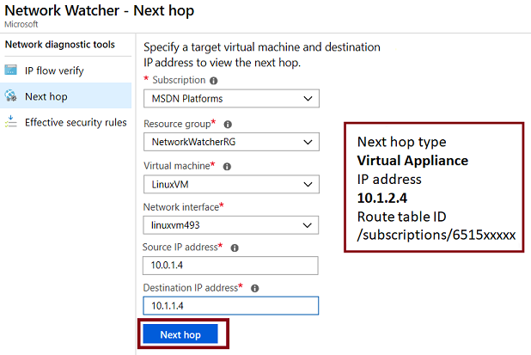
Diagnostics - Next Hop
Helps with determining whether traffic is being directed to the intended destination by showing the next hop

Slide 49
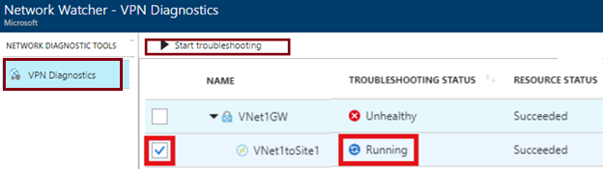
Diagnostics - VPN Diagnostics
Helps you troubleshoot gateways and connections
Provides summary information and detailed information
Can troubleshoot multiple gateways or connections simultaneously
Notes:
✔ You can select multiple gateways or connections to troubleshoot simultaneously or you can focus on an individual component.

Slide 50
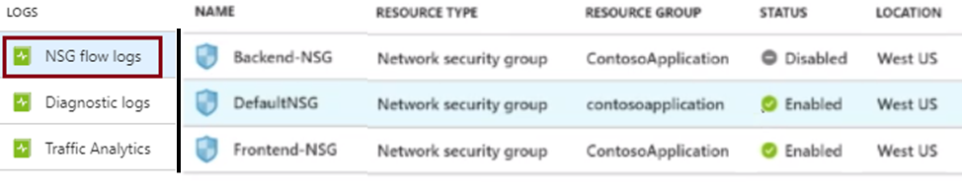
NSG Flow Logs
View information about ingress and egress IP traffic through an NSG
Flow logs are written in JSON format and show outbound and inbound flows on a per rule basis
The JSON format can be visually displayed in Power BI or third-party tools like Kibana
Notes:
✔ These capabilities can be used in security compliance and auditing. You can define a prescriptive set of security rules as a model for security governance in your organization. A periodic compliance audit can be implemented in a programmatic way by comparing the prescriptive rules with the effective rules for each of the VMs in your network.

Slide 51
Connection Troubleshoot
Check connectivity between source VM and destination
Identify configuration issues that are impacting reachability
Provide all possible hop by hop paths from the source to destination
Review hop by hop latency - min, max, and average between source and destination
View a graphical topology from your source to destination
Notes:
For more information, see:
Troubleshoot connections with Azure Network Watcher using the Azure portal - https://docs.microsoft.com/en-us/azure/network-watcher/network-watcher-connectivity-portal

Slide 52
Lesson 05: Lab and Review Questions

Slide 53
Lab – Network Watcher
Adatum Corporation wants to monitor Azure virtual network connectivity by using Azure Network Watcher.
Exercise 1: Prepare infrastructure for Azure Network Watcher-based monitoring
Exercise 2: Use Azure Network Watcher to monitor network connectivity
Lab timing: 60 minutes

Slide 54
Module Review Questions
Notes:
As you have time go through the Module Review questions in the student materials.

Slide 55
Power BI
“Workspace approach, integrating with Power BI Apps, allowing for detailed reporting and data analytics”
Connect to different data sources, create reports and data charts
Get access to powerful dashboards, alerts and drill down for info
Simplify Mgmt, expose IT data to non-IT teams, achieve compliance
Embed interactive data visuals and reporting features into your apps
Monitoring, Management + Business Continuity & Disaster Recovery
Notes:
20535A
12: Monitoring & Automating Azure Solutions

Slide 56
Lesson 3: Automation
Azure Automation Automation Flow Configuration Management
Notes:
20535A
12: Monitoring & Automating Azure Solutions

Slide 57
Azure Automation
Configuration and control plane for Azure, on-premise and other cloud providers:
Robust configuration management toolkit built-in
Access governance and control
Serverless execution of management scripts
Integration with existing platforms, systems and OS features
Notes:
20535A
12: Monitoring & Automating Azure Solutions

Slide 58
Features
Process Automation:
Author runbooks - PowerShell, scripts PowerShell workflow, Graphical, Python2
Hybrid Runbook Workers with Proxy support
Configuration Management:
DSC Configurations, Pull service
Node Management & Reporting
Change tracking & Inventory
Update Management:
Insights across a hybrid Environment
Orchestrated updates and troubleshooting
Notes:
Microsoft Azure Automation provides a way for users to automate the manual, long-running, error-prone, and frequently repeated tasks that are commonly performed in a cloud and enterprise environment. It saves time and increases the reliability of regular administrative tasks and even schedules them to be automatically performed at regular intervals. You can automate processes using runbooks or automate configuration management using Desired State Configuration.
Configuration Management
DSC Configurations, Pull service
Node Management & Reporting
Change tracking & Inventory
Update Management
Insights across your hybrid Environment
Orchestrated updates and troubleshooting
Integration
Included with Azure SDK
Webhooks to start runbook remotely
Process Automation
Author runbooks - PowerShell, scripts PowerShell workflow, Graphical, Python2
Hybrid Runbook Workers with Proxy support
Onboarding
RunAs account for Azure management
Gallery of runbooks and modules from Microsoft and community
20535A
12: Monitoring & Automating Azure Solutions
(More notes on the next slide)

Slide 59

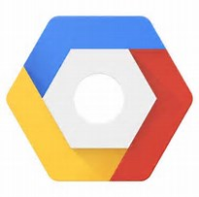





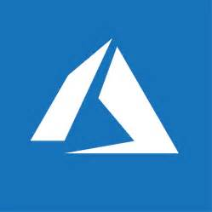
Cross-Cloud
Third party clouds
443 (HTTPS)
Microsoft Azure
Automation
On-premises Datacenters Branch offices datacenters
Secured connection using the Azure Automation Hybrid Worker
Automation tasks are running on-premises, but triggered from Azure Automation
Azure Stack
Notes:
The core component of Azure Automation is defined and configured in the Azure Platform (cross Regions). From there, you can establish hybrid automation capabilities, by using the Azure Automation Hybrid Worker.
This is similar to running like an Azure Automation agent on your non-Azure cloud platforms, where Amazon Web Services, Google Cloud, your own Private Cloud datacenter, or any third party hosted datacenter if you want, would be a good example.
Latest supportability added to the Azure Automation feature set, is integration with on-premises running Azure Stack.
20535A
12: Monitoring & Automating Azure Solutions

Slide 60
Azure Automation Desired State Configuration
Host DSC Scripts and clients pull their configurations automatically
Support for cloud or on-premises VMs and hosts
Simple onboard process for Azure Virtual Machines
Characteristics & Use Cases:
Import, Authoring, Compiling
Integrated source control,
Controlled Distribution to nodes
Reporting
Notes:
20535A
12: Monitoring & Automating Azure Solutions

Slide 61
Desired State Configuration
Automation DSC can be used to manage various machines:
Azure virtual machines running Windows or Linux
Amazon Web Services (AWS) virtual machines running Windows or Linux
Physical/virtual Windows computers on-premises, or in a cloud other than Azure or AWS
Physical/virtual Linux computers on-premises, or in a cloud other than Azure or AWS
Notes:
20535A
12: Monitoring & Automating Azure Solutions

Slide 62
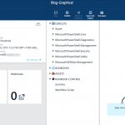
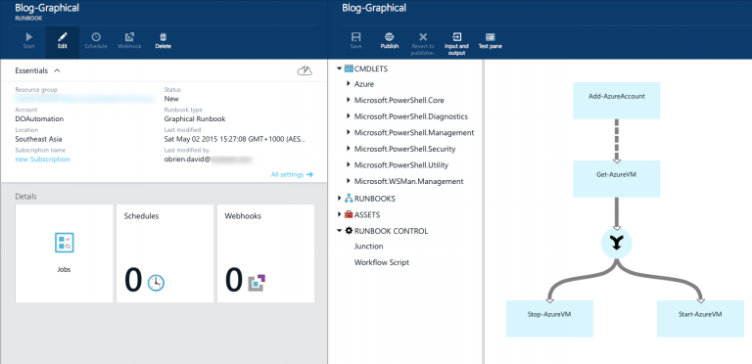
Desired State Configuration
Built-in integration with on-premises systems and PowerShell DSC nodes
Run Azure Automation runbooks on-premises
Automation accessible via new REST API (including GitHub, VSO and ARM)
Graphical workflow-authoring tool
Runbook Management from the new Microsoft Azure portal
Notes:
20535A
12: Monitoring & Automating Azure Solutions

Slide 63





Hybrid Runbook Worker
An on-prem server running MS Mgmt Agent
Executes runbooks downloaded from AA
Reports results back to AA and OMS
Can be deployed in groups for high availability
Requires no ports (outside-in)
On-premises
Runbook Environment
Azure Automation
Microsoft Mgmt Agent
Operations
Management Suite
Hybrid Runbook Worker
Notes:
20535A
12: Monitoring & Automating Azure Solutions

Slide 64




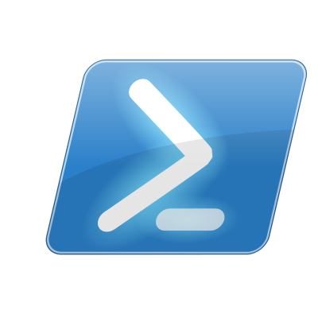





Automation Flow
A
Azure Portal
Azure Automation Runbooks
Webhooks
PowerShell
Alerts
Run actions against Azure Resources
Notes:
20535A
12: Monitoring & Automating Azure Solutions

Slide 65
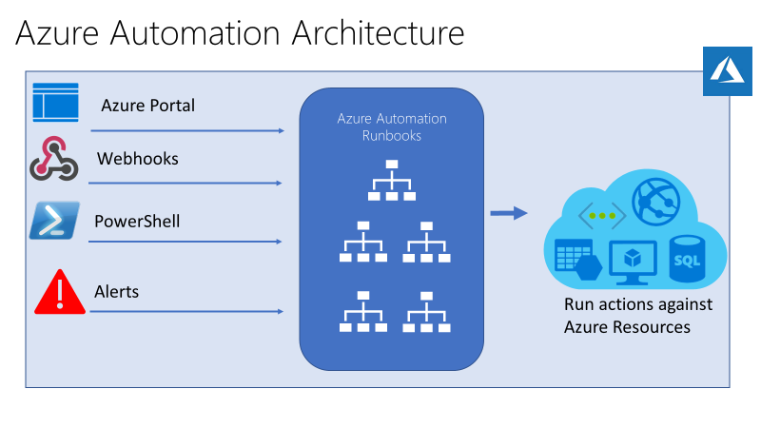
Automation Flow
Run actions against on-premises running Resources, using Hybrid runbook worker group
Notes:
The following image illustrates detailed step-by-step process in the life cycle of a runbook. It includes different ways a runbook is started in Azure Automation, components required for Hybrid Runbook Worker to execute Azure Automation runbooks and interactions between different components. To learn about executing Automation runbooks in your datacenter, refer to hybrid runbook workers.
Very similar in architecture than the previous one, this design emphasizes once more the flexibility and control you have to manage and run configuration scripts across multiple clouds.
20535A
12: Monitoring & Automating Azure Solutions

Slide 66
AZ-203.2 Module 04: Implement Azure Functions
Subtitle or speaker name
Notes:
In this module, you will cover:
Azure Functions.
Developing Azure Functions by using Visual Studio.
Implementing Durable Functions.
Lab: Building a web application on Azure Platform as a Service offerings

Slide 67
Lesson 01: Azure Functions
Notes:
In this lesson, you will cover:
Azure Functions.
Scale and hosting.
Triggers and bindings.
Best practices.

Slide 68
Azure Functions
Solution for running small pieces of code, or "functions," in the cloud:
Write only code that is relevant to business logic
Removes the necessity to write “plumbing” code to connect or host application components
Build on open-source WebJobs code
Supports a wide variety of programming languages, for instance:
Even supports scripting languages, such as:
C#
JAVA
PHP
PY
JS
PS
SH
Notes:
Azure Functions is a solution for easily running small pieces of code, or "functions," in the cloud. You can write just the code you need for the problem at hand, without worrying about a whole application or the infrastructure to run it. Functions can make development even more productive, and you can use your development language of choice, such as C#, F#, Node.js, Java, or PHP. Pay only for the time your code runs and trust Azure to scale as needed. Azure Functions lets you develop serverless applications on Microsoft Azure.
Functions is a great solution for processing data, integrating systems, working with the internet-of-things (IoT), and building simple APIs and microservices. Consider Functions for tasks such as image or order processing, file maintenance, or any tasks that you want to run on a schedule.

Slide 69












Function integrations
Notification Hubs
Event Grid
Event Hubs
Cosmos DB
Twilio
Azure
Functions
Storage
Service Bus
Queue
Blob
Table
Topics
Queues
Notes:
Azure Functions integrates with various Azure and third-party services. These services can trigger your function and start execution, or they can serve as input and output for your code.
The following service integrations are supported by Azure Functions:
Azure Cosmos DB
Azure Event Hubs
Azure Event Grid
Azure Notification Hubs
Azure Service Bus (queues and topics)
Azure Storage (blob, queues, and tables)
On-premises (using Service Bus)
Twilio (SMS messages)

Slide 70
Azure Function (Java program – Function.java)
public class Function {
public String echo(
@HttpTrigger(
name = "request",
methods = {"post"},
authLevel = AuthorizationLevel.ANONYMOUS
)
String request, ExecutionContext context) {
return String.format(request);
}
}
Notes:
This sample Java function provides echo functionality by taking in the body of a HTTP POST request as a string and returning that same body as a response.

Slide 71
Azure Function (Python script – __init__.py)
import logging
import azure.functions as func
def main(myblob: func.InputStream):
logging.info(f"Python blob trigger function processed\n"
f"Name: {myblob.name}\n"
f"Blob Size: {myblob.length} bytes")
Notes:
This sample Python function is triggered by the creation of a new Azure Storage blob. When triggered, it logs information about the blob.

Slide 72
Scale and hosting
You can choose between two types of plans
Consumption
Instances are dynamically instanced and you are charged based on compute time
App Service plan
Traditional App Services model used with Web Apps, API Apps, and Mobile Apps
The type of plan controls:
How host instances are scaled out
The resources that are available to each host
Notes:
Azure Functions runs in two different modes: Consumption plan and Azure App Service plan. The Consumption plan automatically allocates compute power when your code is running. Your app is scaled out when needed to handle load, and scaled down when code is not running. You don't have to pay for idle VMs or reserve capacity in advance.
In either plan, an instance of the Azure Functions host executes the functions.
Consumption Plan
When you're using a Consumption plan, instances of the Azure Functions host are dynamically added and removed based on the number of incoming events. This serverless plan scales automatically, and you're charged for compute resources only when your functions are running. On a Consumption plan, a function execution times out after a configurable period of time.
App Service Plan
In the dedicated App Service plan, your function apps run on dedicated VMs on Basic, Standard, Premium, and Isolated SKUs, which is the same as other App Service apps. Dedicated VMs are allocated to your function app, which means that the functions host can be always running. App Service plans support Linux.

Slide 73


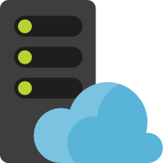
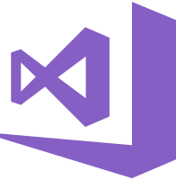
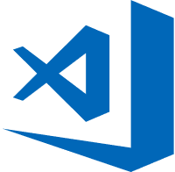
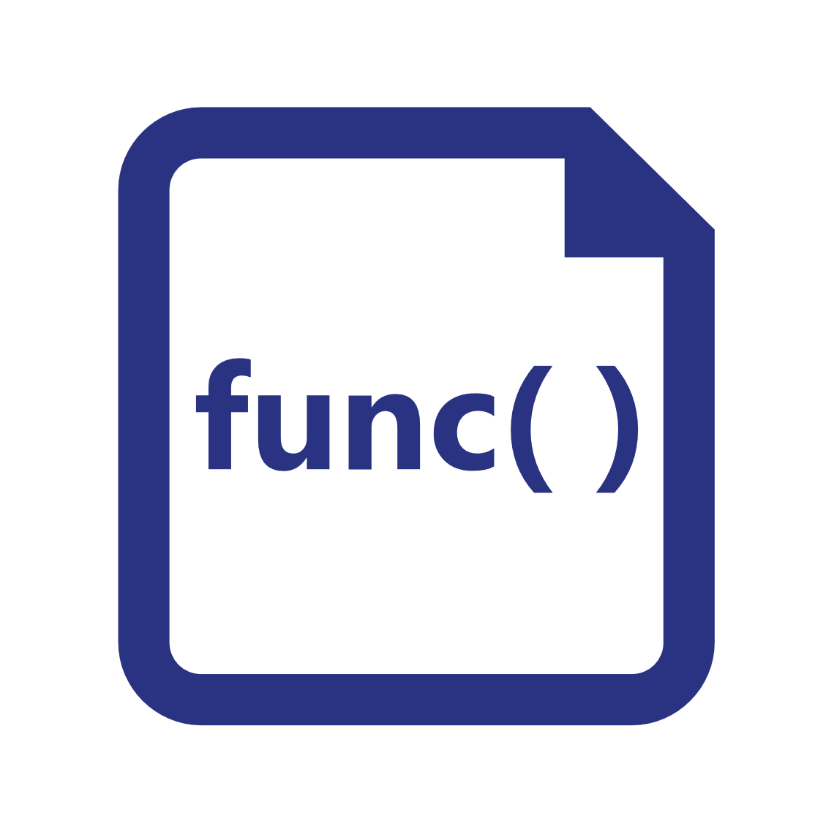

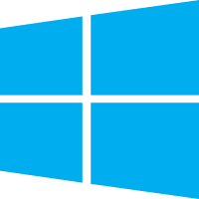


Azure Functions hosting
https://github.com/azure/azure-functions-host (+other repos)
Azure Functions host runtime
Azure Functions Core Tools
Azure Functions base Docker image
Azure Functions .NET Docker image
Azure Functions Node Docker image
●●●
Development
Hosting
Local dev machine
Azure Functions service
Azure Functions service
Azure Functions service
Core Tools + favorite editor
Consumption plan
App Service plan
Premium plan
Platform
+
●●●
Code or container
Code
Code or container
Code
App delivery
Windows, macOS, or Linux
Windows or Linux
Windows or Linux
Windows
OS
Notes:
Azure Functions are designed to be portable and to be hosted in a variety of places, including:
Azure Functions service by using Resource consumption, Premium, or App Service Plans
Internet of Things (IoT) devices

Slide 74

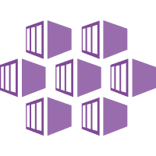

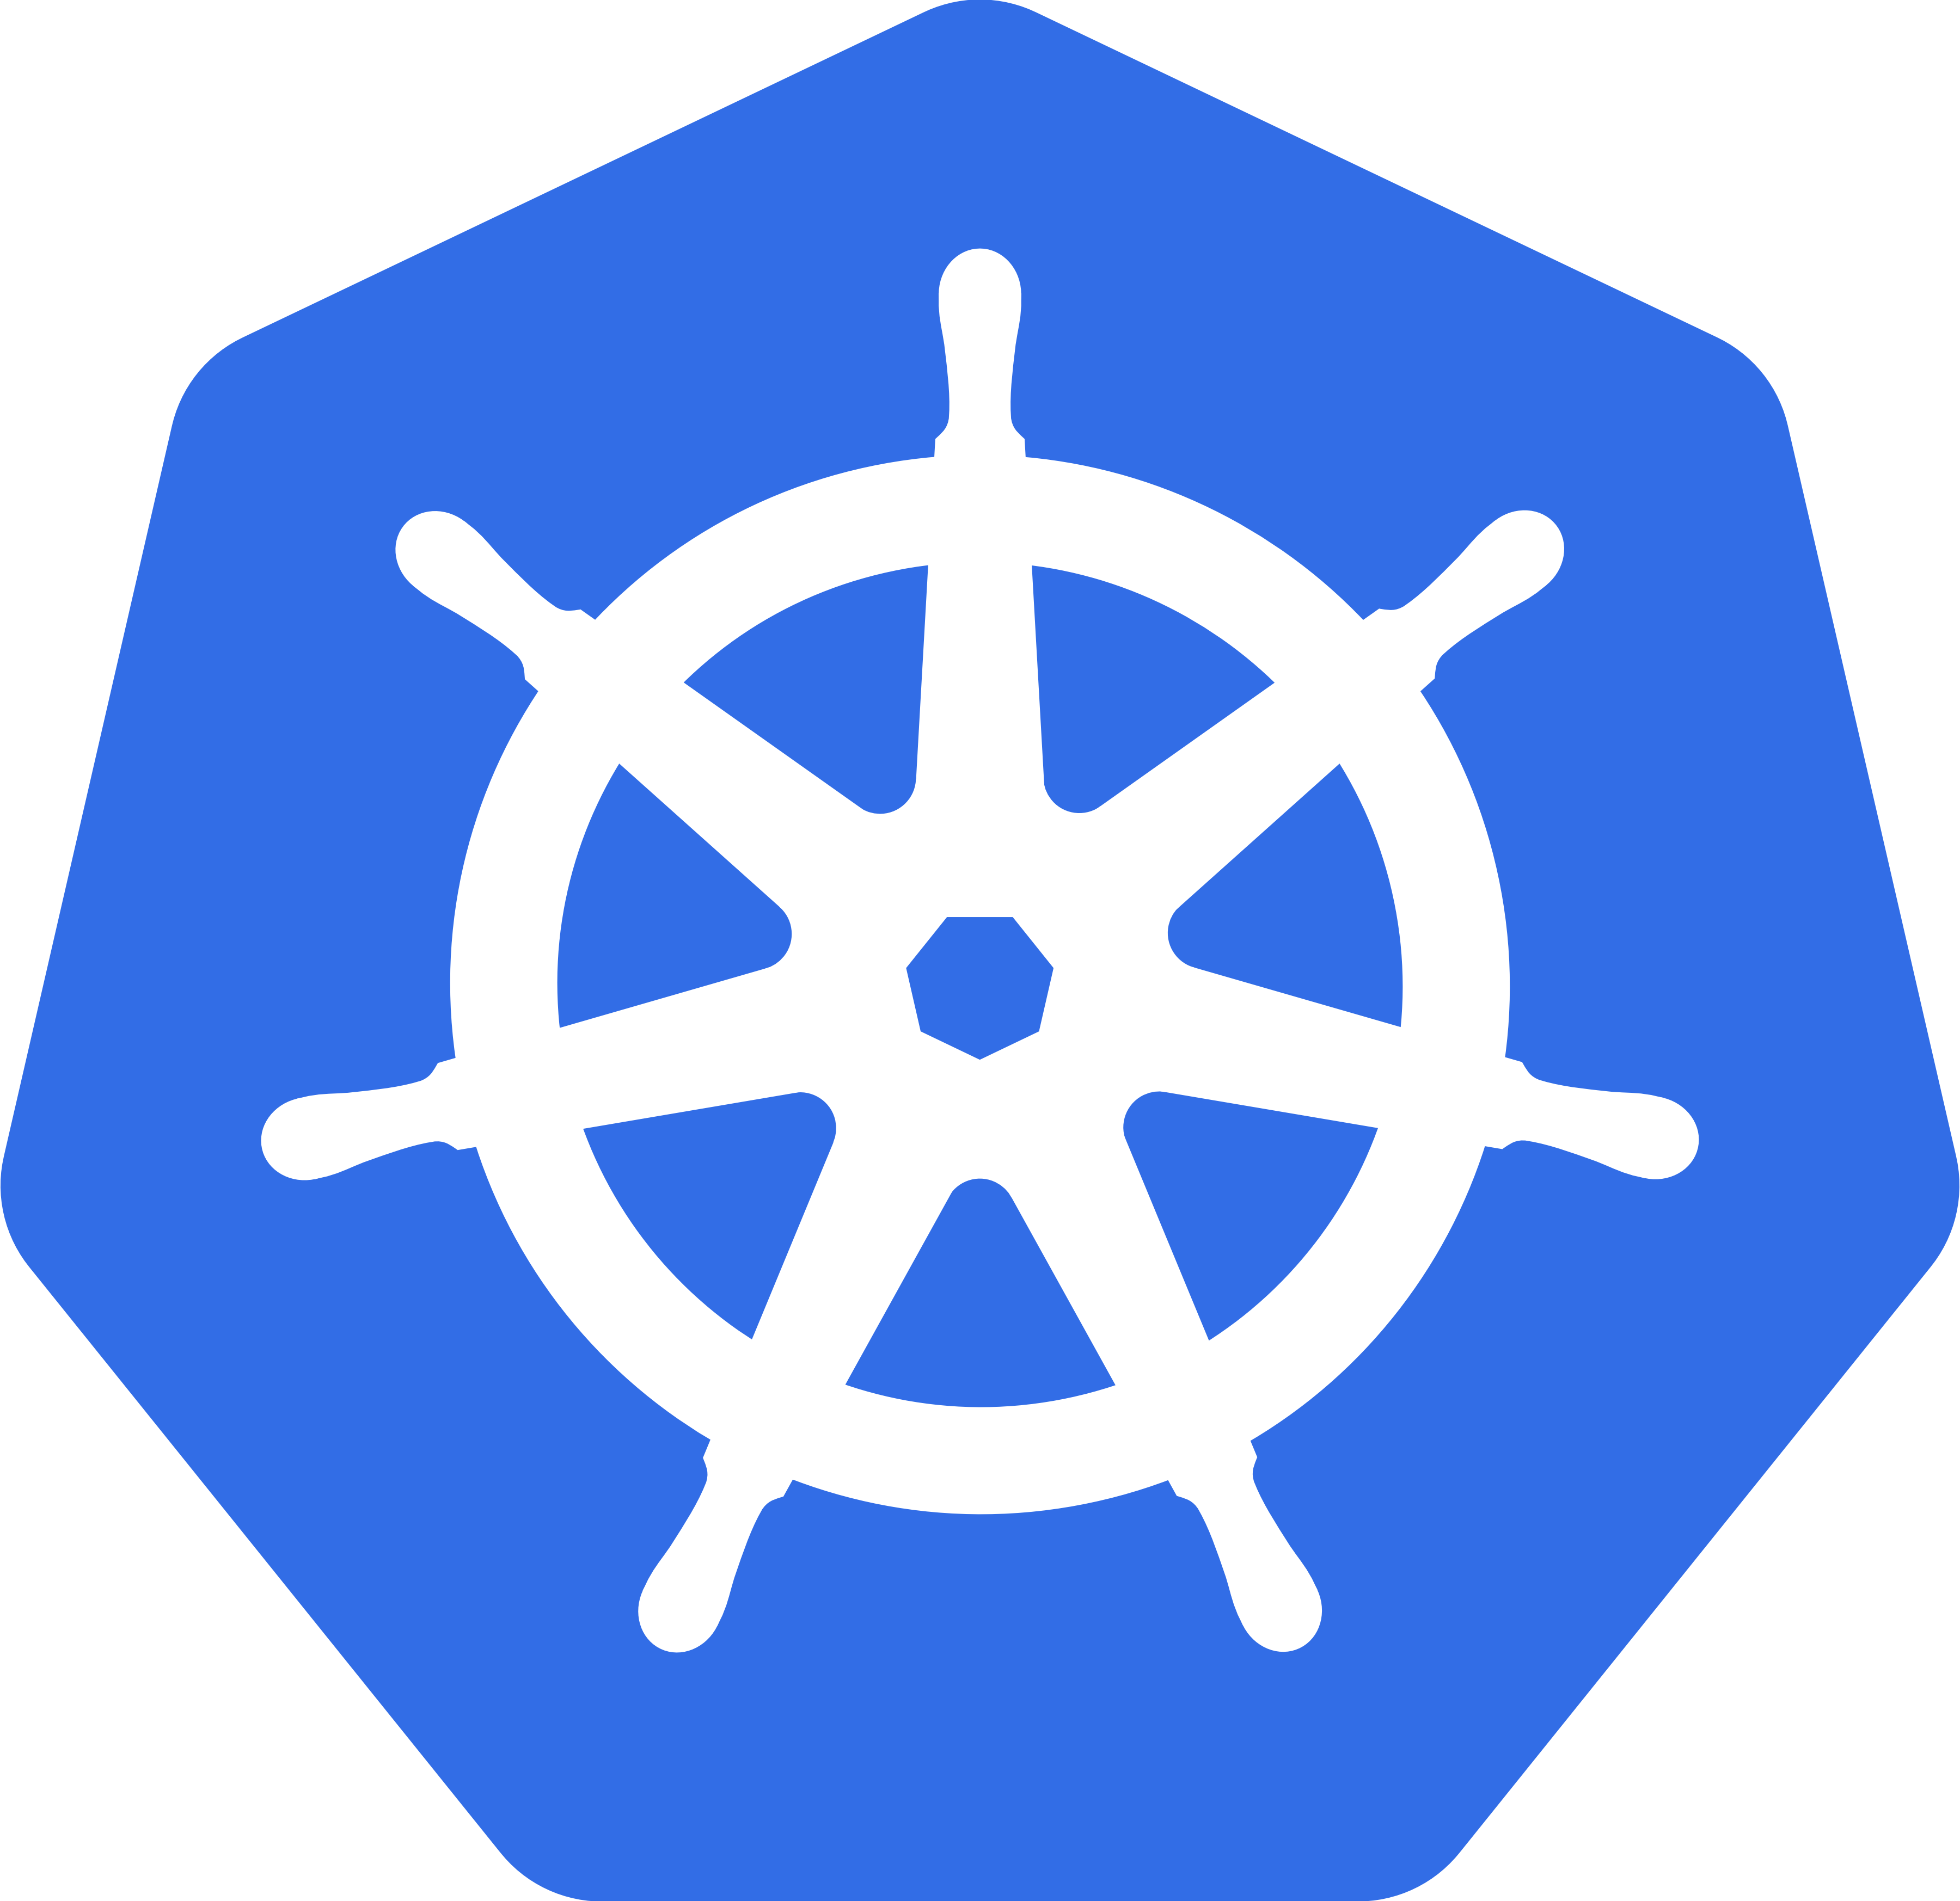
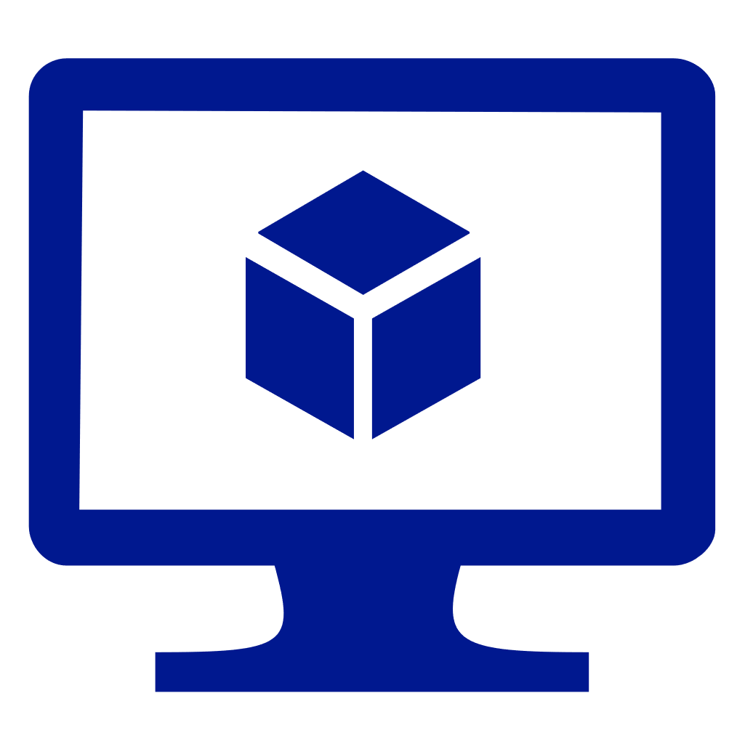

Azure Functions hosting (continued)
https://github.com/azure/azure-functions-host (+other repos)
Azure Functions host runtime
Azure Functions Core Tools
Azure Functions base Docker image
Azure Functions .NET Docker image
Azure Functions Node Docker image
●●●
Hosting
IoT devices
Additional Azure hosts
Non-Azure hosts
On-premises
Azure IoT Edge
AKS, Service Fabric Mesh, …
K8s, raw VMs, & more
App Service on Azure Stack
●●●
●●●
Platform
Container
Container
Container
Code
App delivery
Linux
Linux
Linux
Windows
OS
Notes:
Azure Functions are designed to be portable and to hosted in a variety of places, including:
Azure services that support containerization (Azure Kubernetes Service, Service Fabric, and Azure Container Instances)
Non-Azure container hosts (Kubernetes, Virtual Machines, other cloud providers)
On-premises by using App Service on Azure Stack

Slide 75


Triggers
Execution
Service
Function app
Notes:
A trigger defines how a function is invoked. A function must have exactly one trigger. Triggers have associated data, which is usually the payload that triggers the function.

Slide 76
Trigger types
Triggers based on Azure services
Cosmos DB
Blob and queues
Service Bus
Event Hub
Triggers based on common scenarios
HTTP request
Scheduled timer
Triggers based on third-party services
GitHub
And more…
Notes:
There are many types of triggers for Azure services including:
HTTPTrigger - Trigger the execution of your code by using an HTTP request.
TimerTrigger - Execute cleanup or other batch tasks on a predefined schedule.
GitHub webhook - Respond to events that occur in your GitHub repositories. Generic webhook - process webhook HTTP requests from any service that supports webhooks.
CosmosDBTrigger - Process Azure Cosmos DB documents when they are added or updated in collections in a NoSQL database.
BlobTrigger - Process Azure Storage blobs when they are added to containers. You might use this function for image resizing.
QueueTrigger - Respond to messages as they arrive in an Azure Storage queue.
EventHubTrigger - Respond to events delivered to an Azure Event Hub. Particularly useful in application instrumentation, user experience, or workflow processing, and Internet of Things (IoT) scenarios.
ServiceBusQueueTrigger - Connect your code to other Azure services or on-premises services by listening to message queues.
ServiceBusTopicTrigger - Connect your code to other Azure services or on-premises services by subscribing to topics.

Slide 77

Input and Output Bindings
Service
Input bindings
Output bindings
Output bindings
Trigger
Function app
Input bindings
Service
Service
Notes:
Input and output bindings provide a declarative way to connect to data from within your code. Bindings are optional and an Azure Function can have multiple input and output bindings.

Slide 78
Bindings
Declarative way to connect to data from your code
Connect to services without writing plumbing code
Service credentials are not stored in code
Bindings are optional
Function can have multiple input and output bindings
Output bindings can send data to Azure services such as
Storage
Azure Cosmos DB
Service Bus
Notes:
Triggers and bindings let you avoid hard-coding the details of the services that you're working with. Your function receives data (for example, the content of a queue message) in function parameters. You send data (for example, to create a queue message) by using the return value of the function. In C# and C# script, alternative ways to send data are out parameters and collector objects.

Slide 79



Trigger and Bindings example
L
Blobs
Azure Storage
Schedule trigger
Logs
Query docs
Function app
P
Cosmos DB trigger
Event Hubs
Notes:
In this example, the Function app is triggered by a recurring schedule (nightly) and queries Azure Cosmos DB for a set of documents. The function then processes the documents, outputs blobs to Azure Storage, and outputs logs to Event Hubs.

Slide 80
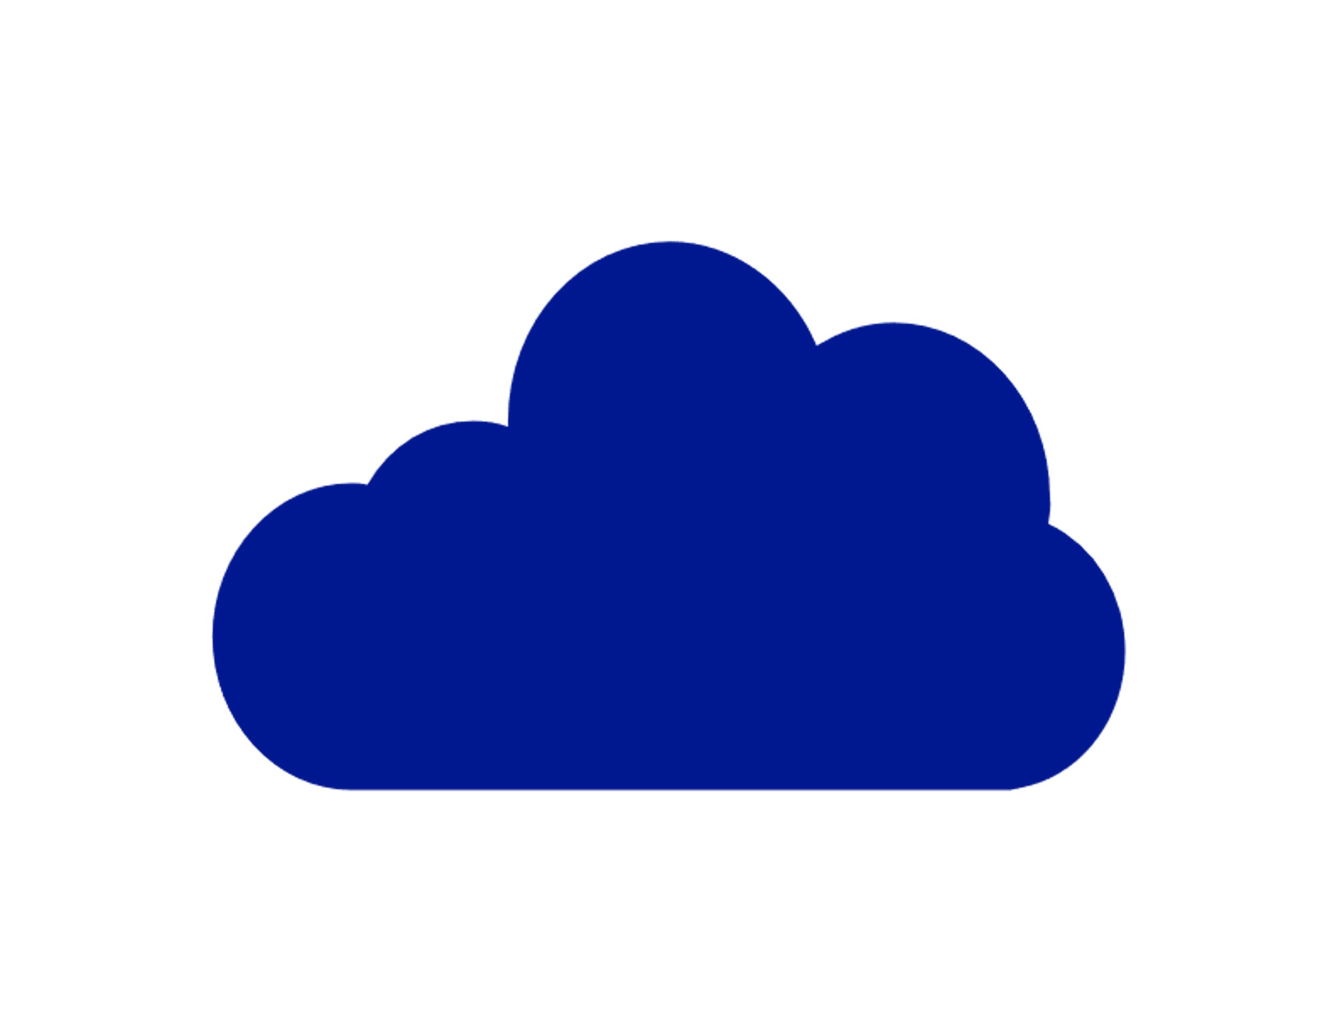

Integrating with Azure Virtual Network
Requires the Premium plan
Secures the inbound HTTP access to your app to one subnet in a Virtual Network
Allows secure outbound calls to resources in a Virtual Network
Internet
HTTP front-ends
Virtual Network
Functions runtime
Notes:
Under the Premium plan, Azure Functions has the same hosting capabilities as the Web Apps in Azure App Service. This means that Azure Functions also has the Virtual Network Integration feature.
When Virtual Network Integration is used with an Azure Virtual Network in the same region as your app, it requires you to use a delegated subnet with at least 32 addresses in it. You won’t be able to use the subnet for anything else. Outbound calls from your app will be made from the addresses in the delegated subnet. When you use this version of Virtual Network Integration, the calls are made from addresses in your Virtual Network.

Slide 81

Azure Virtual Network integration example
Premium App Service plan
Virtual Network Integration
Virtual Network
Internet
Virtual Machines
Function app
Notes:
Using addresses in your VNET enables your app to:
Make calls to service-endpoint secured services.
Access resources across Azure ExpressRoute connections.
Access resources in the Virtual Network that you are connected to.
Access resources across peered connections, including ExpressRoute connections.

Slide 82
Best practices
Avoid long-running functions
Functions that run for a long time can time out
Use queues for cross-function communication
If you require direct communication, consider Durable Functions or Azure Logic Apps
Write stateless functions
Functions should be stateless and idempotent
State data should be associated with your input and output payloads
Code defensively
Assume that your function might need to continue from a previous fail point
Notes:
Avoid long running functions
Large, long-running functions can cause unexpected time-out issues. A function can become large due to many Node.js dependencies. Importing dependencies can also cause increased load times that result in unexpected time-outs. Dependencies are loaded both explicitly and implicitly. A single module loaded by your code may load its own additional modules.
Cross function communication
Durable Functions and Azure Logic Apps are built to manage state transitions and communication between multiple functions. If you are not using Durable Functions or Logic Apps to integrate with multiple functions, it is generally a best practice to use storage queues for cross function communication. The main reason is storage queues are less costly and much easier to provision.
Write functions to be stateless
Functions should be stateless and idempotent if possible. Associate any required state information with your data. For example, an order being processed would likely have an associated state member. A function could process an order based on that state while the function itself remains stateless.
Write defensive functions
Assume that your function could encounter an exception at any time. Design your functions with the ability to continue from a previous fail point during the next execution.

Slide 83
Lesson 02: Develop Azure Functions by using Visual Studio
Notes:
In this lesson, you will cover:
Azure Functions Tools.
Function code.
Bindings.
Creating an Azure Functions project.
Function app settings.

Slide 84
Azure Functions in Visual Studio
Visual Studio project type
Develop, test and deploy C# functions to Azure
Use WebJobs attributes to configure functions in C# code
Pre-compile C# functions
Better cold-start performance
Notes:
Azure Functions is a built-in project type for Visual Studio that lets you develop, test, and deploy C# functions to Azure.
The Azure Functions project type provides the following benefits:
Edit, build, and run functions on your local development computer.
Publish your Azure Functions project directly to Azure.
Use WebJobs attributes to declare function bindings directly in the C# code instead of maintaining a separate function.json for binding definitions.
Develop and deploy precompiled C# functions. Precomplied functions provide a better cold-start performance than C# script-based functions.
Code your functions in C# while having all of the benefits of Visual Studio development.

Slide 85
Function code
using System;
using Microsoft.Azure.WebJobs;
using Microsoft.Azure.WebJobs.Host;
namespace FunctionApp1
{
public static class Function1
{
[FunctionName("QueueTriggerCSharp")]
public static void Run([QueueTrigger("myqueue-items", Connection = "QueueStorage")]string myQueueItem, TraceWriter log)
{
log.Info($"C# Queue trigger function processed: {myQueueItem}");
}
}
}
Notes:
The C# class represents a basic Queue storage triggered function.
A binding-specific attribute is applied to each binding parameter supplied to the entry point method. The attribute takes the binding information as parameters. In the previous example, the first parameter has a QueueTrigger attribute applied, indicating queue triggered function. The queue name and connection string setting name are passed as parameters to the QueueTrigger attribute.

Slide 86
Bindings
{
"bindings": [
{
"name": "order",
"type": "queueTrigger",
"direction": "in",
"queueName": "myqueue-items",
"connection": "MY_STORAGE_ACCT_APP_SETTING"
},
{
"name": "$return",
"type": "table",
"direction": "out",
"tableName": "outTable",
"connection": "MY_TABLE_STORAGE_ACCT_APP_SETTING"
}
]
}
Notes:
Suppose you want to write a new row to Azure Table storage whenever a new message appears in Azure Queue storage. This scenario can be implemented by using an Azure Queue storage trigger and an Azure Table storage output binding.
The first element in the bindings array is the Queue storage trigger. The type and direction properties identify the trigger. The name property identifies the function parameter that receives the queue message content. The name of the queue to monitor is in queueName, and the connection string is in the app setting identified by connection.
The second element in the bindings array is the Azure Table Storage output binding. The type and direction properties identify the binding. The name property specifies how the function provides the new table row, in this case by using the function return value. The name of the table is in tableName, and the connection string is in the app setting identified by connection.
Note: The value of connection is the name of an app setting that contains the connection string, not the connection string itself. Bindings use connection strings stored in app settings to enforce the best practice that function.json does not contain service secrets.

Slide 87
Binding-based code
#r "Newtonsoft.Json"
using Microsoft.Extensions.Logging;
using Newtonsoft.Json.Linq;
public static Person Run(JObject order, ILogger log)
{
return new Person() {
PartitionKey = "Orders",
RowKey = Guid.NewGuid().ToString(),
Name = order["Name"].ToString(),
MobileNumber = order["MobileNumber"].ToString()
};
}
Notes:
Here is C# script code that works with this trigger and binding. Notice that the name of the parameter that provides the queue message content is order; this name is required because the name property value in function.json is order.
The method takes an incoming queue message that is a JSON object, and then add fields and write to Table storage. The method return value creates a new row in Table Storage

Slide 88
Demo: Creating an Azure Functions project
Notes:
This revision of the course does not ship with demo instructions. For each demo, you will be given a list of specific tasks you should demonstrate to your students. The flow, content and structure of your demo is left to you to decide as an instructor.
In this demo, you should show students how to:
Creating an Azure Functions project.
Creating a function.
Add bindings to the Azure Function.
Testing and publishing the Azure Function.

Slide 89
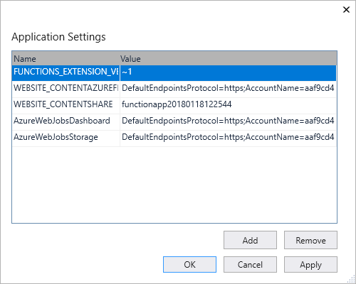
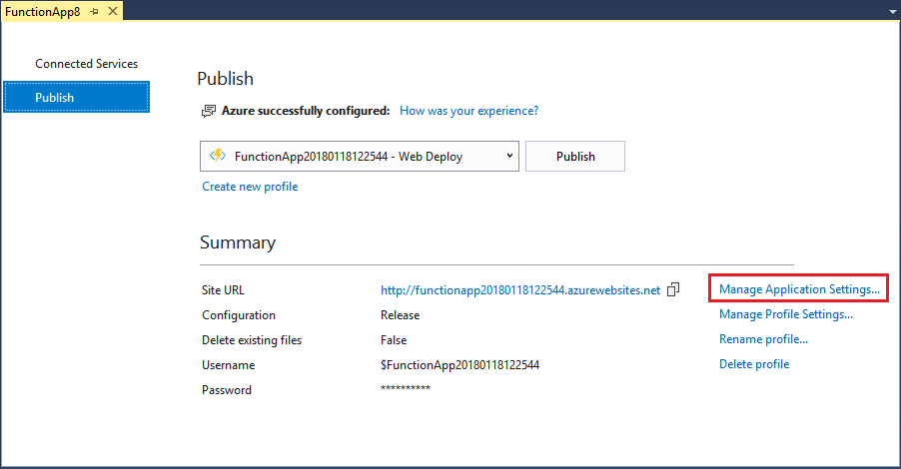
Function App settings
Notes:
Any settings that you added in the local.settings.json must be also added to the Function app in Azure. These settings are not uploaded automatically when you publish the project.
The easiest way to upload the required settings to your function app in Azure is to use the Manage Application Settings link that is displayed after you successfully publish your project.
You can also manage application settings in one of these other ways:
By using the Azure portal.
By using the --publish-local-settings publish option in the Azure Functions Core Tools.
By using the Azure CLI.

Slide 90
Lesson 03: Implement Durable Functions
Notes:
In this lesson, you will cover:
Durable Functions.
Creating a Durable Function in C#.
Fan-out/fan-in Durable Function.

Slide 91
Durable Functions
Write stateful functions in a stateless environment
Manages state, checkpoints, and restarts
Defines an Orchestrator function
Workflows are defined in code
Calls other functions synchronously or asynchronously
Checkpoint progress whenever function awaits
Notes:
Durable Functions is an extension of Azure Functions and Azure WebJobs that lets you write stateful functions in a serverless environment. The extension manages state, checkpoints, and restarts for you.
The extension lets you define stateful workflows in a new type of function called an Orchestrator function. Here are some of the advantages of Orchestrator functions:
They define workflows in code. No JSON schemas or designers are needed.
They can call other functions synchronously and asynchronously. Output from called functions can be saved to local variables.
They automatically checkpoint their progress whenever the function awaits. Local state is never lost if the process recycles or the virtual machine (VM) reboots.
Note: Durable Functions is an advanced extension for Azure Functions that is not appropriate for all applications. The rest of this section assumes that you have a strong familiarity with Azure Functions concepts and the challenges involved in serverless application development.
The primary use case for Durable Functions is simplifying complex, stateful coordination problems in serverless applications. The following sections describe some typical application patterns that can benefit from Durable Functions.

Slide 92

Durable Function scenario - Chaining
Function chaining refers executing a sequence of functions in a particular order. Often, the output of one function needs to be applied to the input of another function.
F1
F2
F3
F4
Notes:
Function chaining refers to the pattern of executing a sequence of functions in a particular order. Often, the output of one function needs to be applied to the input of another function.

Slide 93
Durable Function scenario - Chaining code
public static async Task<object> Run(DurableOrchestrationContext ctx)
{
try
{
var x = await ctx.CallActivityAsync<object>("F1");
var y = await ctx.CallActivityAsync<object>("F2", x);
var z = await ctx.CallActivityAsync<object>("F3", y);
return await ctx.CallActivityAsync<object>("F4", z);
}
catch (Exception)
{
// error handling/compensation goes here
}
}
Notes:
The values "F1", "F2", "F3", and "F4" are the names of other functions in the function app. Control flow is implemented by using normal imperative coding constructs. That is, code executes top down and can involve existing language control flow semantics, like conditionals and loops. Error handling logic can be included in try/catch/finally blocks.
The ctx parameter (DurableOrchestrationContext) provides methods for invoking other functions by name, passing parameters, and returning function output. Each time the code calls await, the Durable Functions framework checkpoints the progress of the current function instance. If the process or VM recycles midway through the execution, the function instance resumes from the previous await call. We will cover more on this restart behavior later.

Slide 94
Durable Function scenario - Fan-out/fan-in
Fan-out/fan-in refers to the pattern of executing multiple functions in parallel, and then waiting for all to finish
F1
F3
F2
Notes:
Fan-out/fan-in refers to the pattern of executing multiple functions in parallel, and then waiting for all to finish. Often, some aggregation work is done on results returned from the functions.
With normal functions, fanning out can be done by having the function send multiple messages to a queue. However, fanning back in is much more challenging. You'd have to write code to track when the queue-triggered functions end and store function outputs. The Durable Functions extension handles this pattern with relatively simple code.

Slide 95
Durable Function scenario - Fan-out/fan-in code
public static async Task Run(DurableOrchestrationContext ctx)
{
var parallelTasks = new List<Task<int>>();
// get a list of N work items to process in parallel
object[] workBatch = await ctx.CallActivityAsync<object[]>("F1");
for (int i = 0; i < workBatch.Length; i++)
{
Task<int> task = ctx.CallActivityAsync<int>("F2", workBatch[i]);
parallelTasks.Add(task);
}
await Task.WhenAll(parallelTasks);
// aggregate all N outputs and send result to F3
int sum = parallelTasks.Sum(t => t.Result);
await ctx.CallActivityAsync("F3", sum);
}
Notes:
The fan-out work is distributed to multiple instances of function F2, and the work is tracked by using a dynamic list of tasks. The .NET Task.WhenAll API is called to wait for all the called functions to finish. Then the F2 function outputs are aggregated from the dynamic task list and passed on to the F3 function.
The automatic checkpointing that happens at the await call on Task.WhenAll ensures that any crash or reboot midway through does not require a restart of any already completed tasks.

Slide 96
Durable Function scenario - Async HTTP APIs
Durable Functions provides built-in APIs that simplify the code that you write for interacting with long-running function executions
Start
DoWork
GetStatus
Notes:
The third pattern is all about the problem of coordinating the state of long-running operations with external clients. A common way to implement this pattern is by having the long-running action triggered by an HTTP call, and then redirecting the client to a status endpoint that they can poll to learn when the operation completes.
Durable Functions provides built-in APIs that simplify the code you write for interacting with long-running function executions. After an instance is started, the extension exposes webhook HTTP APIs that query the Orchestrator function status. The following example shows the REST commands to start an Orchestrator and to query its status. For clarity, some details are omitted from the example.

Slide 97
Durable Function scenario - Async HTTP APIs response
> curl -X POST https://myfunc.azurewebsites.net/orchestrators/DoWork -H "Content-Length: 0" -i
HTTP/1.1 202 Accepted Content-Type: application/json
{ "id":"b79baf67f717453ca9e86c5da21e03ec", ... }
> curl https://myfunc.azurewebsites.net/admin/extensions/DurableTaskExtension/b79baf67f717453ca9e86c5da21e03ec -i
HTTP/1.1 202 Accepted Content-Type: application/json
{ "runtimeStatus":"Running", "lastUpdatedTime":"2017-03-16T21:20:47Z", ... }
> curl https://myfunc.azurewebsites.net/admin/extensions/DurableTaskExtension/b79baf67f717453ca9e86c5da21e03ec -i
HTTP/1.1 200 OK Content-Length: 175 Content-Type: application/json
{ "runtimeStatus":"Completed", "lastUpdatedTime":"2017-03-16T21:20:57Z", ... }
Notes:
Because the state is managed by the Durable Functions runtime, you don't have to implement your own status-tracking mechanism.

Slide 98
Durable Function scenario - Async HTTP APIs code
// HTTP-triggered function to start a new orchestrator function instance.
public static async Task<HttpResponseMessage> Run(
HttpRequestMessage req,
DurableOrchestrationClient starter,
string functionName,
ILogger log)
{
// Function name comes from the request URL.
// Function input comes from the request content.
dynamic eventData = await req.Content.ReadAsAsync<object>();
string instanceId = await starter.StartNewAsync(functionName, eventData);
log.LogInformation($"Started orchestration with ID = '{instanceId}'.");
return starter.CreateCheckStatusResponse(req, instanceId);
}
Notes:
Even though the Durable Functions extension has built-in webhooks for managing long-running orchestrations, you can implement this pattern yourself by using your own function triggers (such as HTTP, queue, or Event Hub) and the orchestrationClient binding. For example, you could use a queue message to trigger termination. Or you could use an HTTP trigger protected by an Azure Active Directory authentication policy instead of the built-in webhooks that use a generated key for authentication.
The DurableOrchestrationClient starter parameter is a value from the orchestrationClient output binding, which is part of the Durable Functions extension. It provides methods for starting, sending events to, terminating, and querying for new or existing Orchestrator function instances. In the previous example, an HTTP triggered-function takes in a functionName value from the incoming URL and passes that value to StartNewAsync. This binding API then returns a response that contains a Location header and additional information about the instance that can later be used to look up the status of the started instance or terminate it.

Slide 99
Durable Function scenario - Monitoring
The monitor pattern refers to a flexible recurring process in a workflow—for example, polling until certain conditions are met
Notes:
The monitor pattern refers to a flexible recurring process in a workflow—for example, polling until certain conditions are met. A regular timer-trigger can address a simple scenario, such as a periodic cleanup job, but its interval is static and managing instance lifetimes becomes complex. Durable Functions enables flexible recurrence intervals, task lifetime management, and the ability to create multiple monitor processes from a single orchestration.
An example would be reversing the earlier async HTTP API scenario. Instead of exposing an endpoint for an external client to monitor a long-running operation, the long-running monitor consumes an external endpoint, waiting for some state change.
Using Durable Functions, multiple monitors that observe arbitrary endpoints can be created in a few lines of code. The monitors can end execution when some condition is met, or be terminated by the DurableOrchestrationClient, and their wait interval can be changed based on some condition (that is, exponential backoff). The code on the next slide implements a basic monitor.

Slide 100
Durable Function scenario - Monitoring code
public static async Task Run(DurableOrchestrationContext ctx)
{
int jobId = ctx.GetInput<int>(); int pollingInterval = GetPollingInterval();
DateTime expiryTime = GetExpiryTime();
while (ctx.CurrentUtcDateTime < expiryTime)
{
var jobStatus = await ctx.CallActivityAsync<string>("GetJobStatus", jobId);
if (jobStatus == "Completed")
{ await ctx.CallActivityAsync("SendAlert", machineId); break; }
// Orchestration will sleep until this time
var nextCheck = ctx.CurrentUtcDateTime.AddSeconds(pollingInterval);
await ctx.CreateTimer(nextCheck, CancellationToken.None);
}
// Perform further work here, or let the orchestration end
}
Notes:
When a request is received, a new orchestration instance is created for that job ID. The instance polls a status until a condition is met and the loop is exited. A durable timer is used to control the polling interval. Further work can then be performed, or the orchestration can end. When the ctx.CurrentUtcDateTime exceeds the expiryTime, the monitor ends.

Slide 101



Durable Function scenario - Human interaction
Many processes involve human interaction. Automated processes must allow for human low availability, and they often do so by using time-outs and compensation logic.
ProcessApproval
RequestApproval
Escalate
Notes:
Many processes involve some kind of human interaction. The tricky thing about involving humans in an automated process is that people are not always as highly available and responsive as cloud services. Automated processes must allow for this, and they often do so by using timeouts and compensation logic.
One example of a business process that involves human interaction is an approval process. For example, approval from a manager might be required for an expense report that exceeds a certain amount. If the manager does not approve within 72 hours (maybe the manager went on vacation), an escalation process starts to get the approval from someone else (perhaps the manager's manager).
This pattern can be implemented by using an Orchestrator function. The Orchestrator would use a durable timer to request approval and escalate in case of timeout. It would wait for an external event, which would be the notification generated by some human interaction.

Slide 102
Durable Function scenario - Human interaction code
public static async Task Run(DurableOrchestrationContext ctx)
{
await ctx.CallActivityAsync("RequestApproval");
using (var timeoutCts = new CancellationTokenSource())
{
DateTime dueTime = ctx.CurrentUtcDateTime.AddHours(72);
Task durableTimeout = ctx.CreateTimer(dueTime, timeoutCts.Token);
Task<bool> approval = ctx.WaitForExternalEvent<bool>("ApprovalEvent");
if (approvalEvent == await Task.WhenAny(approvalEvent, durableTimeout))
{
timeoutCts.Cancel();
await ctx.CallActivityAsync("ProcessApproval", approval.Result);
} else
{ await ctx.CallActivityAsync("Escalate"); }
}
}
Notes:
The durable timer is created by calling ctx.CreateTimer. The notification is received by ctx.WaitForExternalEvent. And Task.WhenAny is called to decide whether to escalate (timeout happens first) or process approval (approval is received before time-out).

Slide 103
Durable Function scenario - Human interaction code (continued)
public static async Task Run(string instanceId, DurableOrchestrationClient client)
{
bool isApproved = true;
await client.RaiseEventAsync(instanceId, "ApprovalEvent", isApproved);
}
Notes:
An external client can deliver the event notification to a waiting Orchestrator function by using either the built-in HTTP APIs or by using DurableOrchestrationClient.RaiseEventAsync API from another function.

Slide 104
Demo: Create a Durable Function in C#
Notes:
In this tutorial, you learn how to use the tools for Azure Functions to locally create and test a durable function. This function will orchestrate and chain together calls to other functions. You then publish the function code to Azure.
This revision of the course does not ship with demo instructions. For each demo, you will be given a list of specific tasks you should demonstrate to your students. The flow, content and structure of your demo is left to you to decide as an instructor.
In this demo, you should show students how to:
Create a durable function using the Azure Functions extension for Visual Studio Code.
Create a starter function, orchestrator function and various activity functions.
Deploy and validate the function in Azure.

Slide 105

Lab: Building a web application on Azure Platform-as-a-Service offerings
Notes:
You are the owner of a startup organization and have been building an image gallery application for people to share great images of food. To get your product to market as quickly as possible, you decided to use Microsoft Azure App Service to host your web applications and APIs. Recently, you realized that the images that are being uploaded to your application are simply too large. Out of concern for storage and bandwidth costs, you decided to use Azure Functions to process images in the background and shrink them down to thumbnails that can be loaded quickly.

Slide 106
Lab Login Information
Virtual Machine
AZ203-SEA-DEV
Username: Admin
Password: Pa55w.rd
Notes:
Sign in to the lab virtual machine
Ensure that your students are signed in to their Windows 10 virtual machine by using the following credentials:
Username: Admin
Password: Pa55w.rd

Slide 107
Review
Azure Functions
Develop Azure Functions by using Visual Studio
Implement Durable Functions
Lab: Building a web application on Azure Platform-as-a-Service offerings
Notes:
These are the topics that we discussed in this module.

Slide 109
AZ-103T00A Module 09: Active Directory

Slide 110
Module Overview
Azure Active Directory
Azure AD Connect
AD Join
Lab and Review Questions
Notes:
Module overview

Slide 111
Lesson 01: Azure Active Directory

Slide 112
Azure Active Directory Overview
Azure Active Directory
Azure Active Directory Benefits
Azure Active Directory Differences
Azure Active Directory Editions
Azure AD Directories (Tenants)
Notes:
Lesson overview

Slide 113
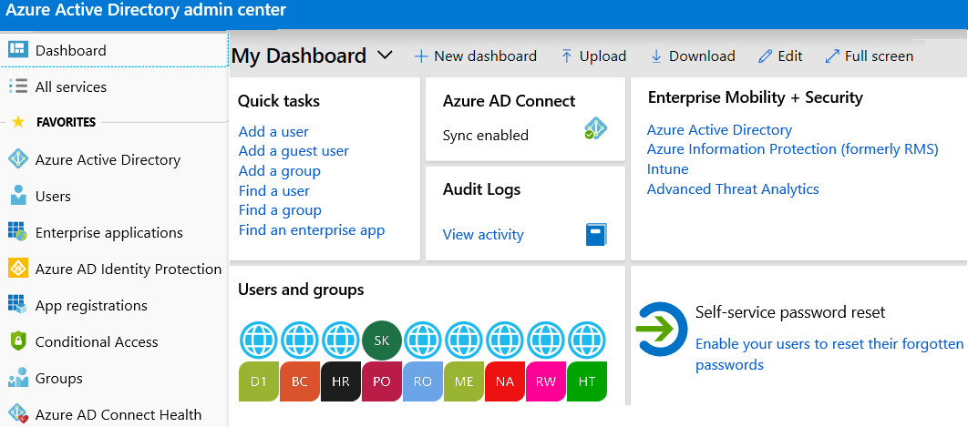
Azure Active Directory
A full suite of identity management capabilities including multi-factor authentication, device registration, self-service password management, privileged account management, RBAC, monitoring, auditing, and alerting
Notes:
✔️ If you are an Office365, Azure or Dynamics CRM Online customer, you might not realize that you are already using Azure AD. Every Office365, Azure and Dynamics CRM tenant is already an Azure AD tenant. Whenever you want you can start using that tenant to manage access to thousands of other cloud applications Azure AD integrates with.
✔️ There is an Azure Active Directory Admin Center at https://aad.portal.azure.com.
For more information, you can see:
Azure Active Directory Documentation - https://docs.microsoft.com/en-us/azure/active-directory/

Slide 114
Azure Active Directory Benefits
Single sign-on to any cloud or on-premises web app
Compatible with iOS, Mac OS X, Android, and Windows devices
Protect on-premises web applications with secure remote access
Extend AD to the cloud
Help protect sensitive data and applications
Notes:
✔️ What reasons do you have for considering Azure Active Directory?

Slide 115
Azure Active Directory Differences
Azure AD is primarily an identity solution, and designed for HTTP and HTTPS communications
Queried using the REST API over HTTP and HTTPS. Instead of LDAP.
Uses HTTP and HTTPS protocols such as SAML, WS-Federation, and OpenID Connect for authentication (and OAuth for authorization). Instead of Kerberos
Includes federation services, and many third-party services (such as Facebook)
Azure AD users and groups are created in a flat structure, and there are no Organizational Units (OUs) or Group Policy Objects (GPOs)
Notes:
✔️ Azure AD is a managed service. You only manage the users, groups, and policies. Deploying AD DS with virtual machines using Azure means that you manage the deployment, configuration, virtual machines, patching, and other backend tasks. Do you see the difference? How are they similar?

Slide 116
Azure Active Directory Editions
Feature | Free | Office 365 Apps | Premium P1 | Premium P2
Directory Objects | 500,000 objects | No object limit | No object limit | No object limit
Single Sign-On | Up to 10 apps | Up to 10 apps | Unlimited | Unlimited
Core Identity and Access | X | X | X | X
B2B Collaboration | X | X | X | X
Identity & Access for O365 |  | X | X | X
Premium Features |  |  | X | X
Hybrid Identities |  |  | X | X
Advanced Group Access |  |  | X | X
Conditional Access |  |  | X | X
Identity Protection |  |  |  | X
Identity Governance |  |  |  | X
Notes:
✔️ Did you look through the pricing list to determine which features your organization needs and to compare edition capabilities?
For more information, you can see:
Azure AD Pricing Editions - https://azure.microsoft.com/en-us/pricing/details/active-directory/

Slide 117
Azure AD Directories (Tenants)
A tenant is a dedicated instance of an Azure AD directory
You can have multiple tenants for:
Resource independence
Administrative independence
Synchronization independence

Slide 118
Lesson 02: Azure Active Directory Connect

Slide 119
Azure Active Directory Connect Overview
Azure AD Connect
AD Connect Topologies
Authentication Options
Password Hash Synchronization (PHS)
Pass-through Authentication (PTA)
Federation with Azure AD
Password Writeback
Azure AD Connect Health
Notes:
Lesson overview

Slide 120

Azure AD Connect
Integrate your on-premises directories with Azure Active Directory
Provides a common identity for your users for Office 365, Azure, and SaaS applications integrated with Azure AD
There are several authentication options
Enables hybrid identity

Slide 121




AD Connect Topologies
Single forests, single tenant
Multiple forests, single tenant
Staging servers
Unsupported topologies
Notes:
Topologies for Azure AD Connect - https://docs.microsoft.com/en-us/azure/active-directory/hybrid/plan-connect-topologies

Slide 122

Authentication Options
Password Hash Synchronization (PHS) can synchronize an encrypted version of the password hash for user accounts
Pass-through authentication (PTA) authenticates the username and password with the on-premises domain controllers
AD FS is the Microsoft implementation of an identity federation solution that uses claims-based authentication
Notes:
Take time to look at the decision flow chart in the student materials.

Slide 123

Password Hash Synchronization
Password hash synchronizes user passwords from on-premises Active Directory to cloud-based Azure AD
Sign in to Azure AD services using the on-premises password
Improve the productivity of your users and reduce your helpdesk costs
Notes:
✔️ This is same sign-in, not single sign-on. The user still authenticates against two separate directory services.

Slide 124

Pass-through Authentication
Supports user sign-in into all web browser-based applications and into Microsoft Office client applications
Is a free feature and can be enabled via Azure AD Connect
Is not only for user sign-in but allows an organization to use other Azure AD features – MFA and Self-Service Password Reset

Slide 125

Federation with Azure AD
Federation is a collection of domains that have established trust
You can federate your on-premises environment with Azure AD and use this federation for authentication and authorization
This sign-in method ensures that all user authentication occurs on-premises

Slide 126

Password Writeback
Use Password Writeback to configure Azure AD to write passwords back to your on-premises Active Directory
A component of Azure AD Connect
Available to subscribers of Premium Azure Active Directory editions
Removes the need to set up and manage an on-premises SSPR solution
Notes:
✔️ Use the link below to read about the password writeback features. Which of the features are you most interested in?

Slide 127

Azure AD Connect Health
Monitor and gain insights into AD FS servers, Azure AD Connect, and AD domain controllers
Monitor and gain insights into the synchronizations that occur between your on-premises AD DS and Azure AD
Monitor and gain insights into your on-premises identity infrastructure that is used to access Office 365 or other Azure AD applications

Slide 128
Lesson 03: Azure AD Join

Slide 129
Azure AD Join Overview
Device Management
Azure AD Joined Devices
Hybrid AD Joined Devices
Configuring Azure AD Join
Notes:
Lesson overview

Slide 130
Device Management
Azure AD enables SSO to devices from anywhere (BYOD)
Registering a device
Enable a registered device to authenticate when the user signs-in
Disable the device, as needed
Joining a device
Extends a registered device - all the benefits of registration
Changes the local state of device
Sign-in using an organizational work or school account instead of a personal account
Notes:
✔️ Registration combined with a mobile device management (MDM) solution such as Microsoft Intune, provides additional device attributes in Azure AD. This allows you to create conditional access rules that enforce access from devices to meet your standards for security and compliance.
For more information, you can see:
Introduction to device management - https://docs.microsoft.com/en-us/azure/active-directory/device-management-introduction

Slide 131

Azure AD Joined Devices
Single-Sign-On (SSO) to your Azure managed SaaS apps and services
Enterprise compliant roaming of user settings across joined devices
Access to Windows Store for Business
Windows Hello support
Restriction of access to apps from only compliant devices
Seamless access to on-premise resources
Notes:
✔️ Although AD Join is intended for organizations that do not have on-premises Windows Server Active Directory infrastructure it can be used for other scenarios like branch offices. Read more at the reference link.

Slide 132
Hybrid Azure AD Joined Devices
 | Registered Devices | Azure AD Joined Devices | Hybrid AD Joined Devices
Device Type | Personal | Organization owned | Organization owned
Registration | Manual | Manual | Automatic
Operating System | Windows 10 | Windows 10 | Windows 7, 8, and 10
Devices joined to both devices on-premises AD and Azure AD
Central management of work-owned
Users to sign in to their devices with their AD work or school accounts
Notes:
✔️ Are you understanding the different types of joined devices? Which do you think your organization needs?

Slide 133

Configuring Azure AD Join
Select the users who can join devices to Azure AD
Select the users that are granted local administrator rights on a device
Allow Azure AD joined or hybrid Azure AD joined to register with Azure AD
Require MFA to join devices
Select the maximum number of devices a user can have
Allow user’s settings and app data to sync across their Windows 10 devices

Slide 134
Lesson 04: Lab and Review Questions

Slide 135
Lab – Implement Directory Synchronization
Adatum Corporation wants to integrate its Active Directory with Azure Active Directory.
Exercise 1. Deploy an Azure VM hosting an Active Directory domain controller.
Exercise 2. Create and configure an Azure Active Directory tenant
Exercise 3. Synchronize Active Directory forest with an Azure Active Directory tenant
Lab time: 60 minutes

Slide 136
Module Review Questions
Notes:
As you have time go through the Module Review questions in the student materials.

